Slide 1
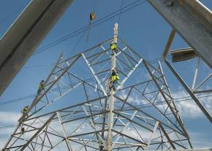
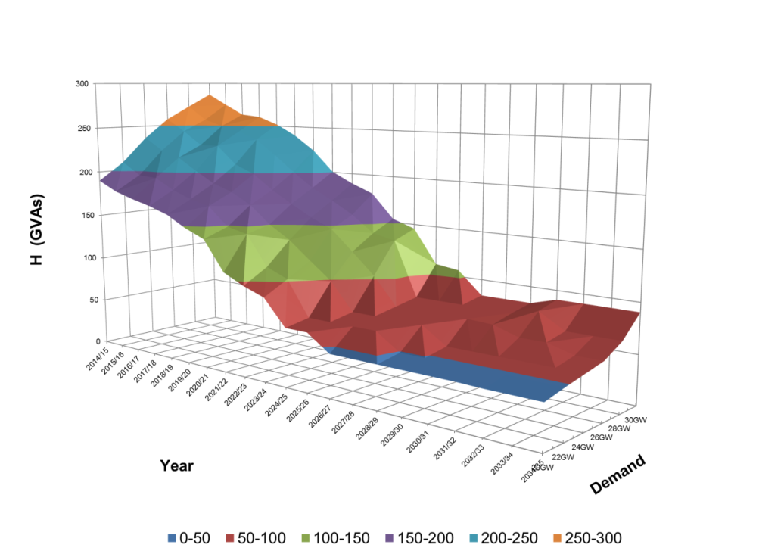
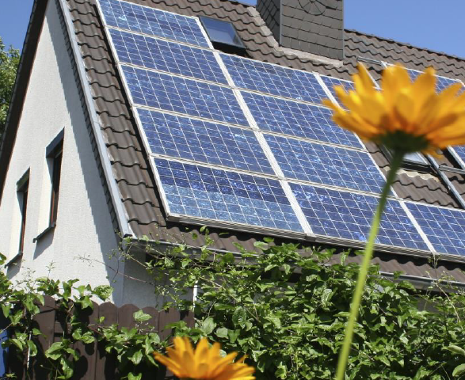
Network Innovation Competition:
SMART Frequency Control
(Enhanced Frequency Control Capability, EFCC)
Charlotte Grant March 2015

Slide 2
Why SMART Frequency Control? (1)
System Operability Framework….
  Forecasted reduction of system inertia from 360GW/s to 150GW/s (by 2025 under Slow Progression or 2022 with Gone Green)
  RoCoF increasing from 0.125Hz/s to 0.3Hz/s
Increasing variability of system inertia
Under GG scenario, potential additional cost of ~£200m to carry larger volume of response reserve
Fast frequency control to maintain operability and reduce cost
SMART Frequency Control project (Enhanced Frequency Control Capability, EFCC) to demonstrate the effectiveness/capability from providers

Slide 3


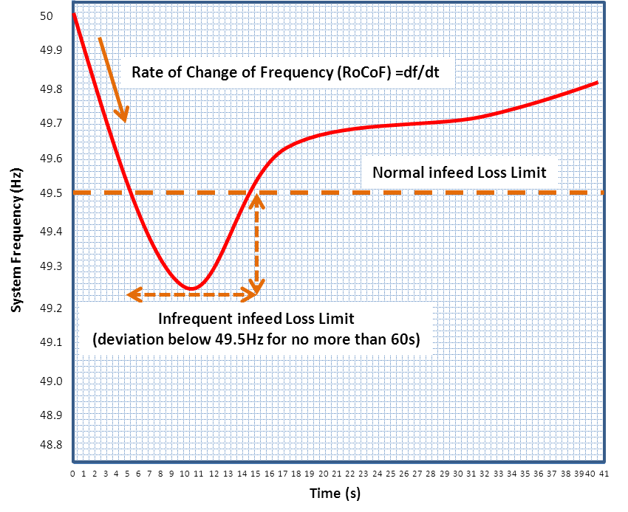
Why SMART Frequency Control? (2)
NIC EFCC project awarded by Ofgem November 2014
New Services | Solution
 | Enhanced Frequency Control (Fast Response)
 | Low Load Operation of Thermal Plants
 | Synchronous Compensator

Slide 4
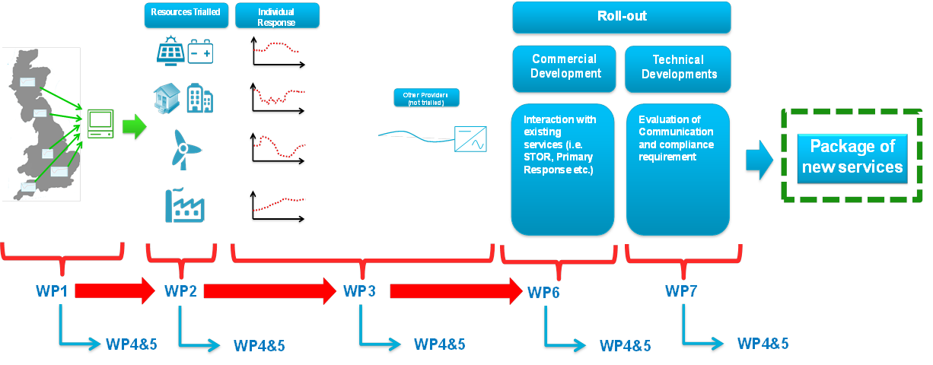
SMART Frequency Control – Project overview
Jan 2015
Mar 2018
Notes:
Concept
Regional frequency monitoring
Storage (review of existing storage facilities and various power outputs)
Response within 0.5s with trials of 0.1s
testing max initial response
RoCoF following
Setpoint following
DSR (response within 5s with longer term)
Solar PV (potential to combine with storage)
Response through reducing output (within 0.5s)
Windfarms
Provision of additional power (10%) output within 0.2 – 0.5s and sustained if wind conditions allow
Synthetic inertia
Conventional CCGT
Commercial development
Control room interfaces and communication/compliance

Slide 5

SMART Frequency Control – Work Packages & Collaboration
Work Package 1 - Control System
  Event detection and control
Work Package 2 - Assess response from service providers
Work Package 3 - Optimisation
Work Package 4 - Validation
Work Package 5 - Knowledge dissemination
Work Package 6 - Commercial
  Development of commercial frameworks
Work Package 7 - Communication
  Control room interfaces

Slide 6
SMART Frequency Control Project
Organisational Structure
SO Innovation Board
Project Sponsor(s)
  Richard Smith (NG)
  John West (NG)
Steering Committee
  Vandad Hamidi (NG) – PD
  Charlotte Grant (NG) - PM
  Malcolm Hay (Alstom)
  Douglas Wilson (Alstom)
  Alastair Martin (Flextricity)
  Christopher Proudfoot (Centrica)
  Duncan Bott (Belectric)
  Tim Mueller (Belectric)
  Campbell Booth (Strathclyde University)
  Vladimir Terzija (Manchester University)
PMO Support
  Lisa Cressy (NG)
Advisory Group
(advisory sessions as per project requiements
  Andrew Dixon (NG)
  John Zammit-Haber (NG)
  Paul Auckland (NG)/ David Oram (NG)
  Martin Bradley (NG)
  Mike Edgar (NG)
  Leon Walker (NG)
  Sarah Hall (NG)
  Adam Sims (NG)
  Graham Stein (NG)
  Mark Osborne (NG)
  Bernie Dolan (NG)
  Phil Johnson (NG)

Slide 7
SMART Frequency Control – First 6 months
Main milestones
  Completion of control specification
  Analysis of storage costs and benefits; report with recommendations to be sent to Ofgem
  Project progress report
Notes:
Alstom to complete specification including algorithm (April 2015)
Review of existing storage facilities and their capabilities. Assessment of benefit of having combined solar PV and storage including CBA, recommendations (June 2015)
1st bi-annual progress report (June 2015)

