Slide 1
The Enhanced Frequency Control Capability (EFCC) Project
The future of frequency control

Slide 2
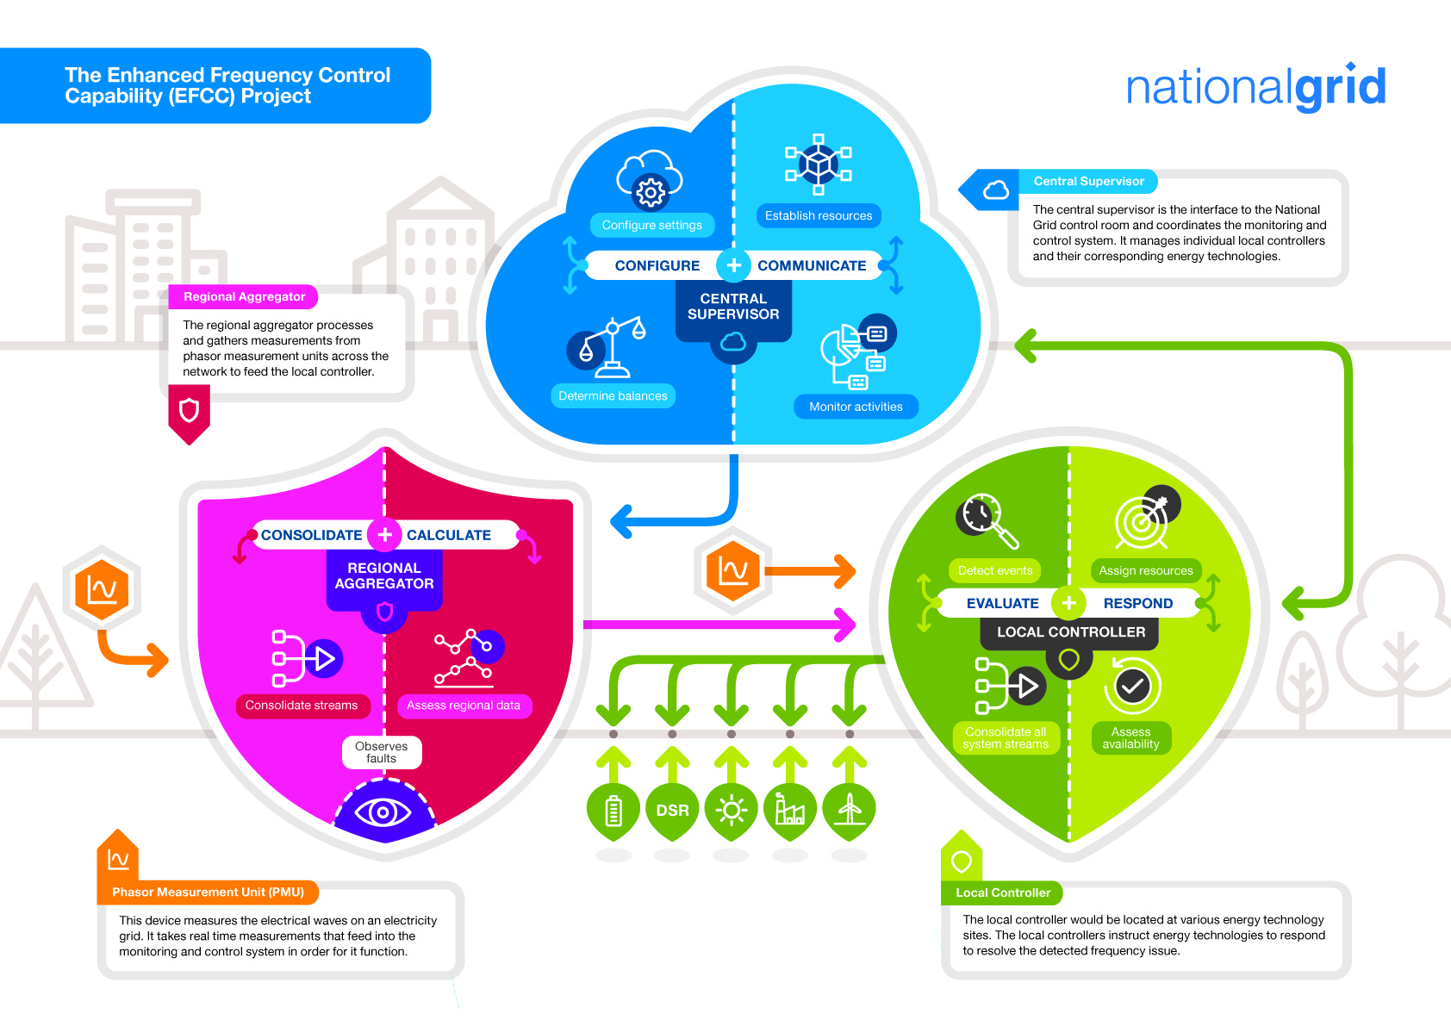
EFCC – the future of frequency control
Three year, £8.5 million project which started in 2015
Changes to the energy landscape have identified potential future system operability challenges
Focus on one of those challenges – reduction in system inertia
Provision of rapid frequency response, from a diverse range of technologies, to assist with frequency management
Underpinned by a monitoring and control system (MCS) that facilities the coordination of and maximises the contribution from resource providers

Slide 3
Collaboration with the industry and academia
Responsible for the development of the monitoring and control system
Provide a response from their solar PV plants and their storage facilities (NIA DESERT)
Progressing with customers from industrial and commercial sectors for demand side response trials
Providing a view of large-scale thermal generation response by implementing revised frequency control logic
Results validation and sharing the learnings from the project
Demonstrating how wind farms can provide fast frequency response

Slide 4
Changing energy landscape: what has changed?
Changes in how electricity is used and sourced presents future system operability challenges
Increased volumes of renewable generation and interconnectors, coupled with a reduction of thermal generation has, and will continue to reduce system inertia levels
Frequency is more volatile when system inertia is low
Reducing system inertia requires faster delivery of response, managed by using greater quantities of response. Ultimately faster services are required to achieve frequency containment with acceptable dynamic performance

Slide 5
How will NIC EFCC assist with the future system operability challenges?
Development of an innovated MCS
Obtain accurate frequency data at a regional level. Calculate and initiate the required rate and volume of rapid frequency response
Obtain rapid frequency response from more sustainable technologies
Increased visibility of system performance (real time) and the potential to open the balancing service market to new participants

Slide 6
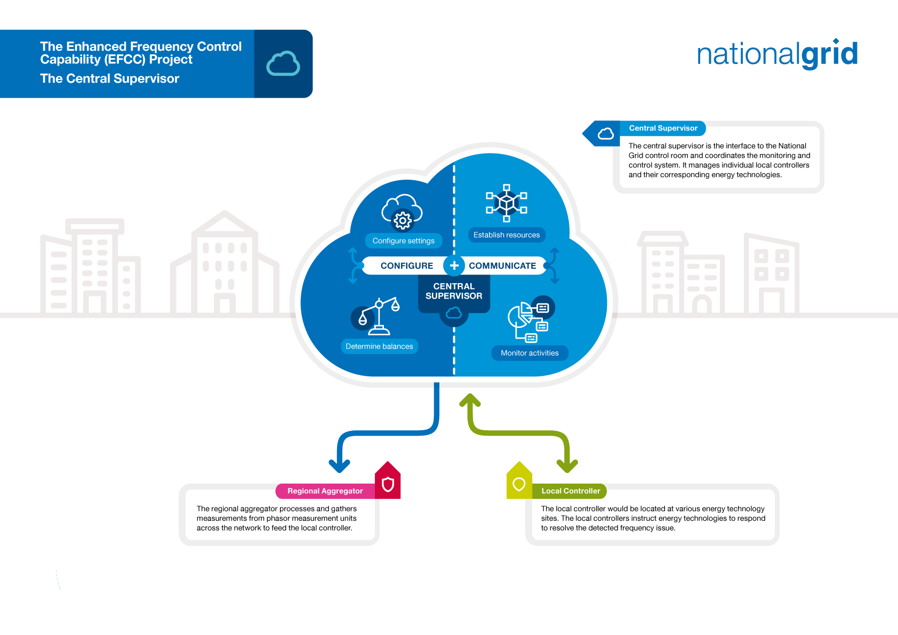
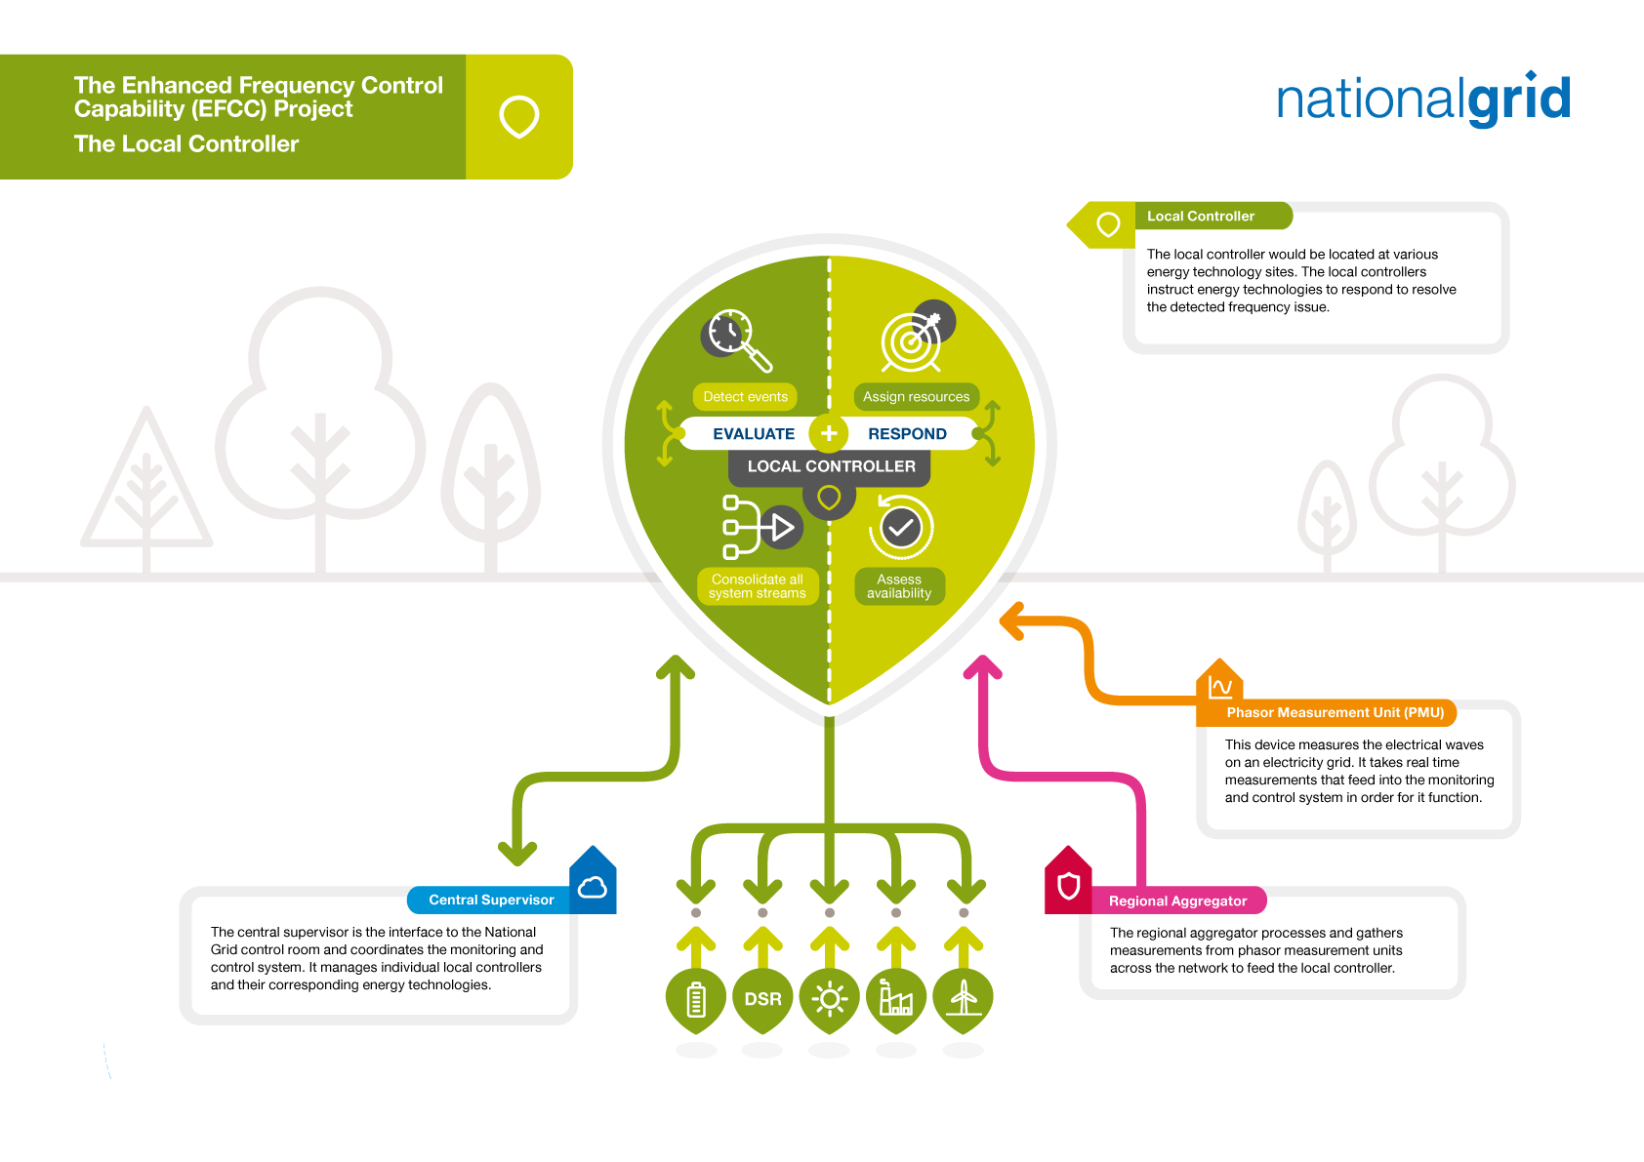

Slide 7
Providing additional functionality to the current balancing services
Current with EFR
Future with EFCC
Achieves 100% active power output at 1 second (or less)
Proportional/static
National
Technology agnostic
Standard comms network
Individual response
Achieves 100% active power < 1 second (target 500 ms)
Rate of Change of Frequency triggered
Regional
Technology agnostic
Fast comms network
Coordinated response

Slide 8
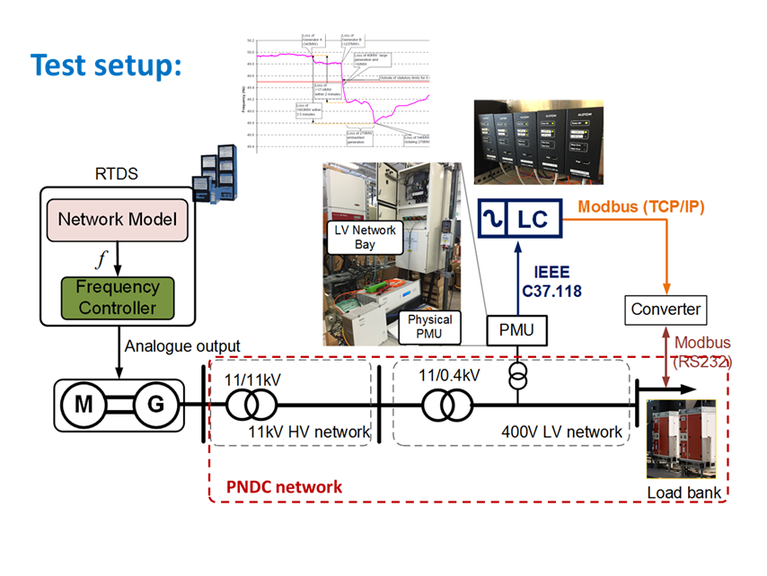
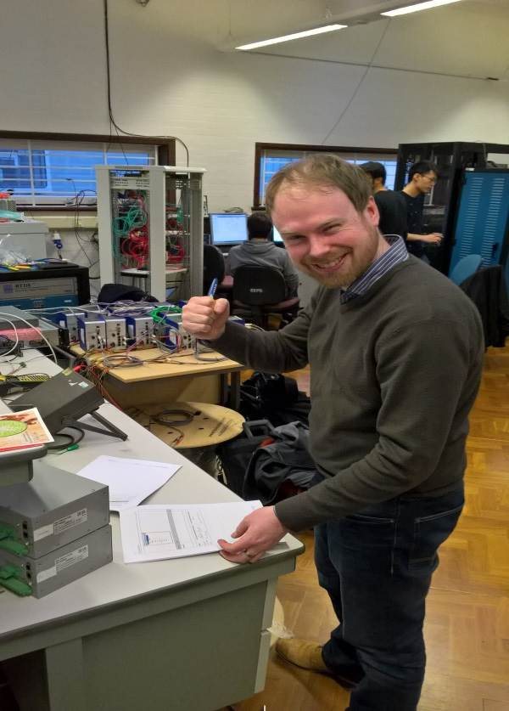
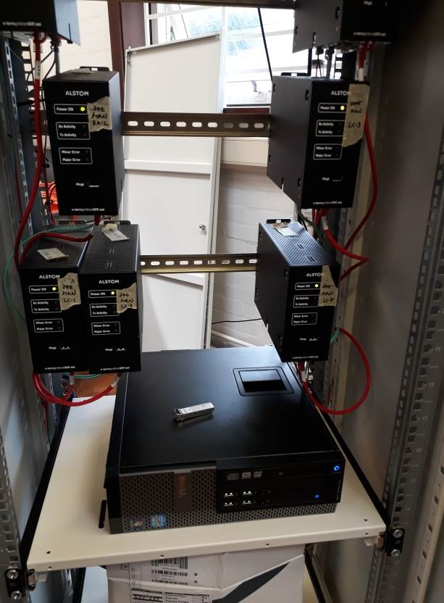
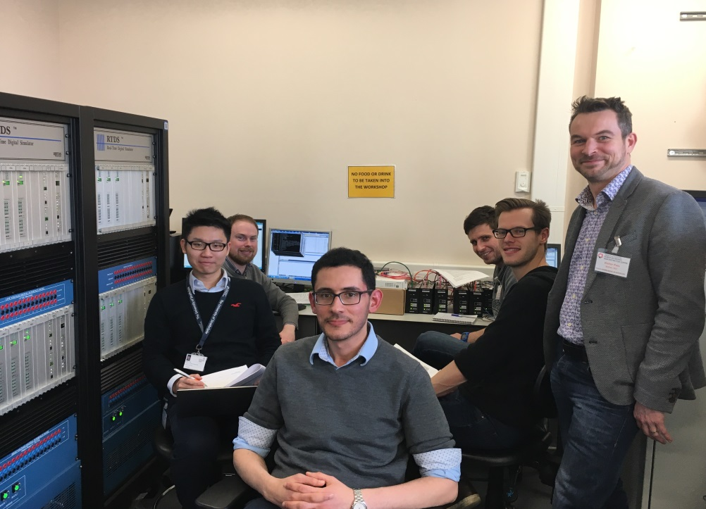
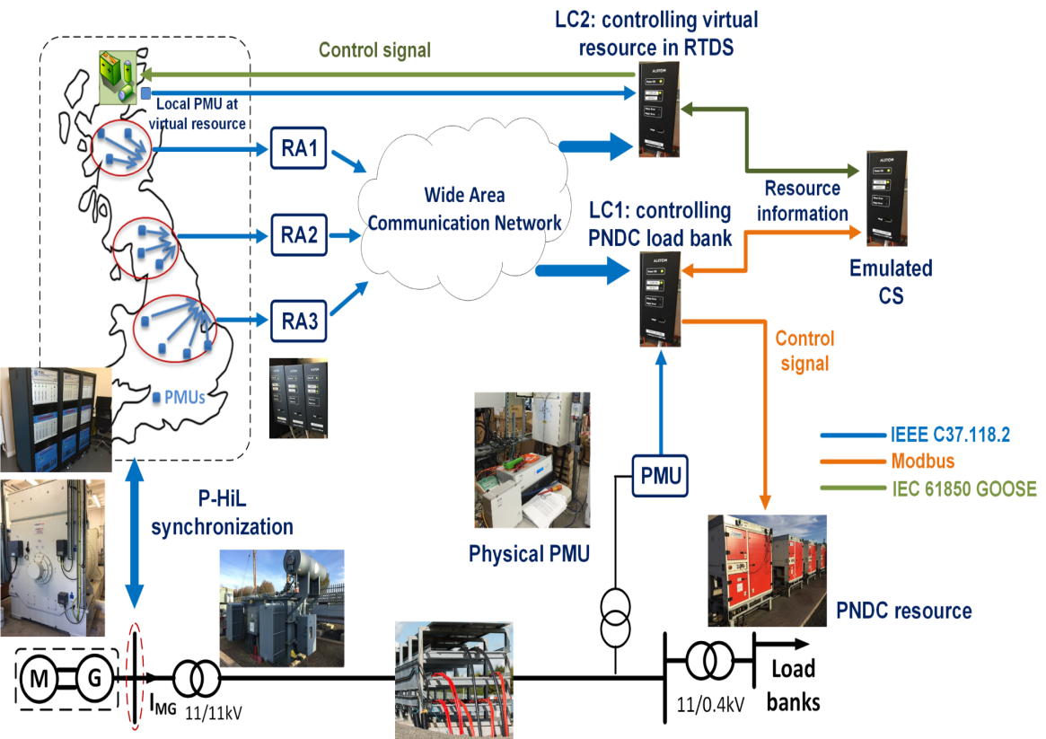
NIC EFCC: the story so far
Successful development of monitoring and control system
Installation of monitoring and control system at partner sites
Extensive testing of the system
Functionality component parts
Operational modes (local and wider)
Data communications
End to end testing

Slide 9
NIC EFCC: the story so far
Demand Side Response – successfully recruited third party for trial participation in three categories – trials nearing completion
Combined cycle gas turbine (CCGT) - Successful simulation and field trial for fast frequency response
Solar and Battery - monitoring and control system equipment installed and battery being commissioned followed by testing
Wind - testing undertaken (both test and field) with results being reviewed

Slide 10
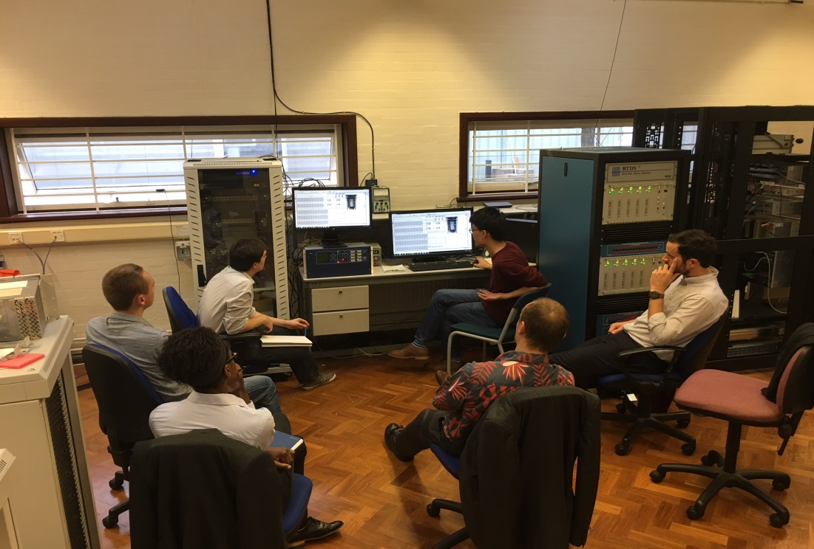
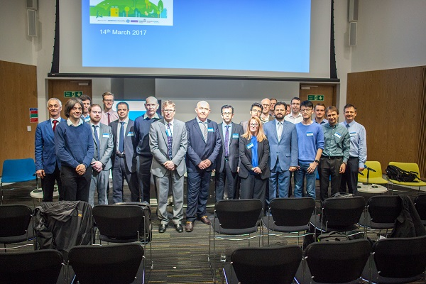
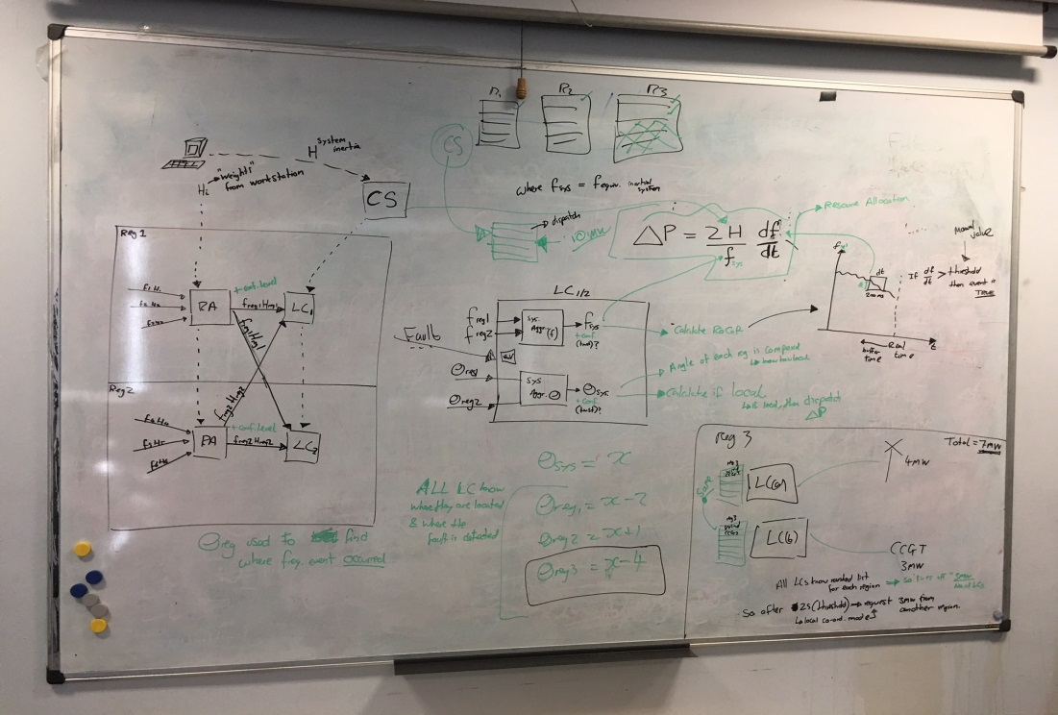
NIC EFCC: the story so far
Data communication – mapping out how the system will integrate with existing National Grid infrastructure
Commercial – align with other industry initiatives (System Needs and Product Strategy)
Successful dissemination in 2016 and 2017

Slide 11
NIC EFCC: next steps
Conclusion of the field trials and system testing
provision of rapid frequency response from diverse range of technologies and the integration of the monitoring and control system equipment
National Grid will be deploying the EFCC concept onto the network, valuable learning to be gained
Completion of data communication and commercial work packages
Dissemination Events
27th and 28th March 2018 – dissemination event
Project Website: http://www2.nationalgrid.com/UK/Ourcompany/Innovation/NIC/EFCC/
LCNI Stand: National Grid

