Slide 1


Future Energy Scenarios 2015
Demand
Russell Fowler
Power Demand Manager

Slide 2
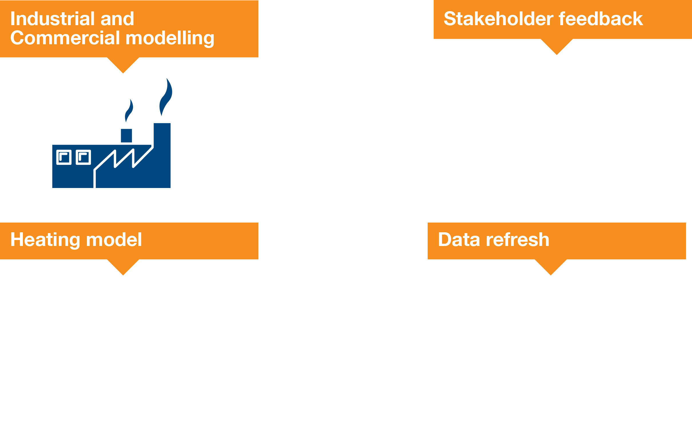
What’s changed?
Notes:
We have continued to develop out analytical and modelling capability:
For industrial and commercial modelling, we are working with ARUP for both gas and power. We now look, on top on the usual econometrics, how the relative costs of fuels and how they interplay effects demand. We also consider a wider number of industrial and commercial sectors to give richer picture of demand
We are working with DELTA ee and have a new residential heating model, this also looks at a wider range of technologies, how they fit in homes and also allows us to consider the so called softer aspects e.g. ”I can afford it, it fits, but I just don't like it”
We refresh our data sources every year, e.g.:
On the gas side, as some will know, is the re-evaluation of Composite Weather Variable, the relationship between demand and weather, this has lead to a drop in peak demand.
On the power side seen a number of low carbon network funded reports being published – these have shaped our analysis of new technologies.
Finally is our stakeholder engagement from last years FES. We have spoken more people again this year, lots of new people and those who have been with FES since the beginning.
When we were out with FES 2014 a number of comments around our energy efficiency assumptions started to emerge – this lead us to look again at these. We then engaged further in this specific area an revised our assumptions for energy efficiency. Interestingly we had the similar comments across power and gas - which gave confidence to our new assumptions. So, this year we have less energy efficiency than last year, we look forward to your views on this

Slide 3
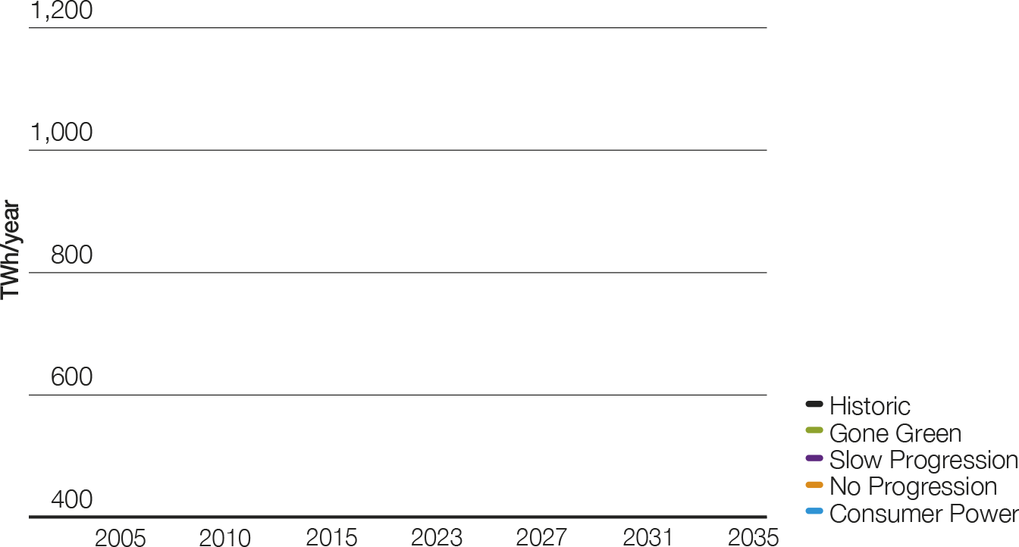
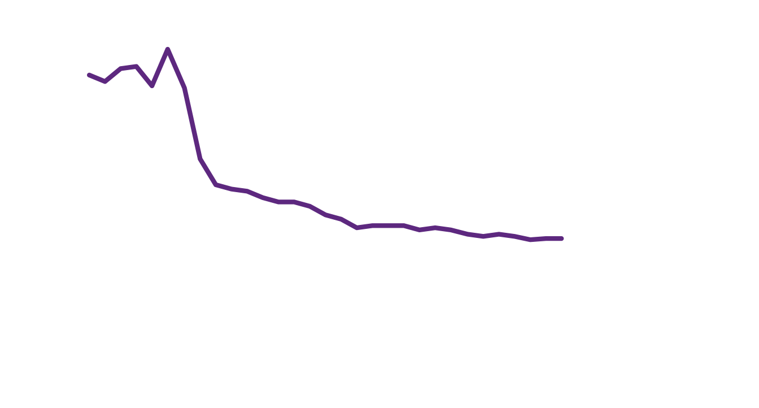
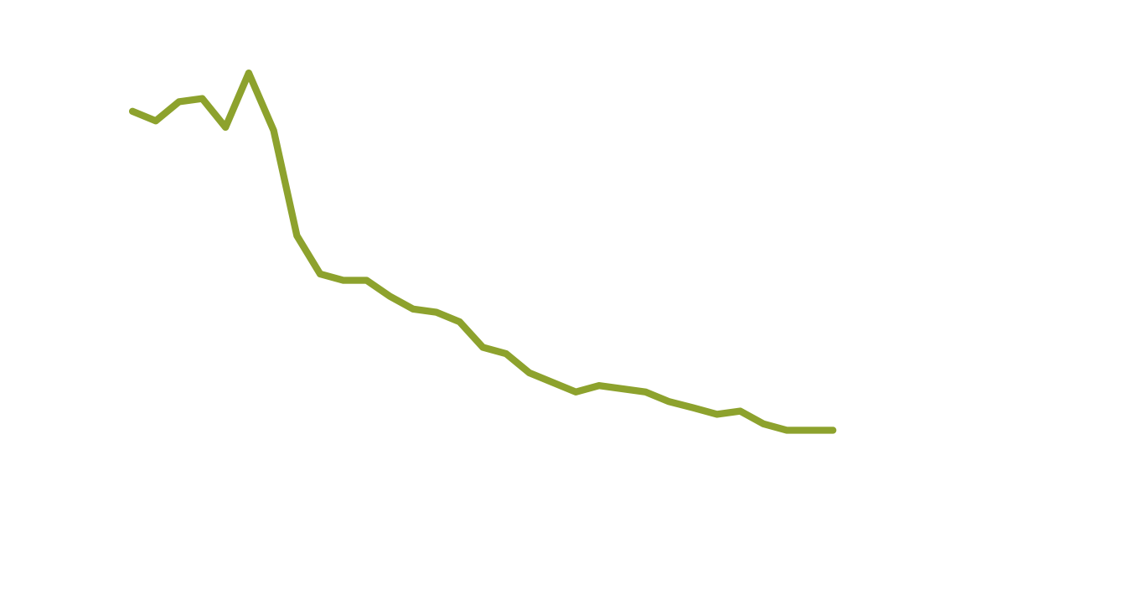
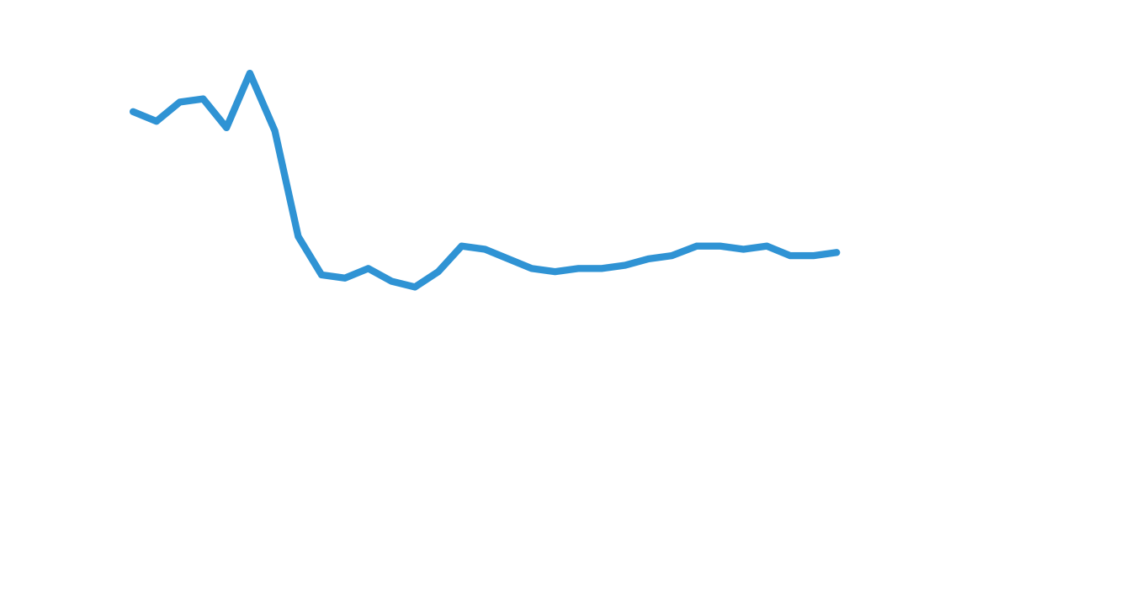
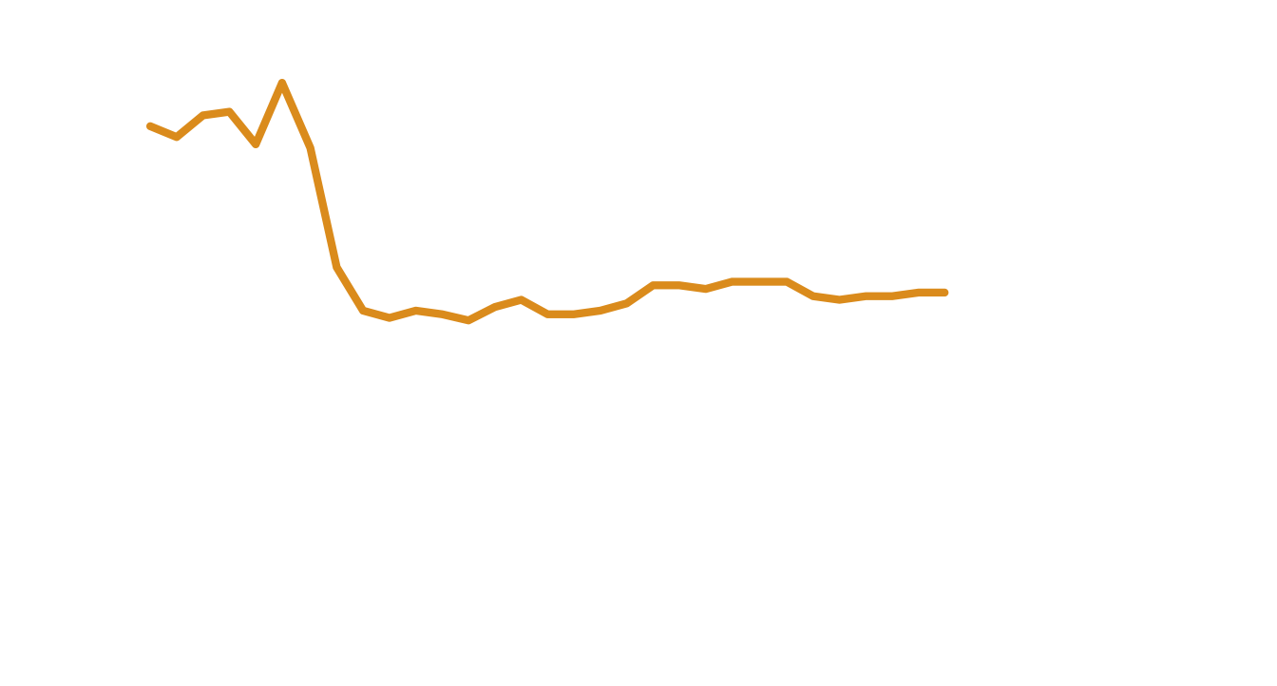

Gas demand
Lower demand for gas
in the scenarios with higher
green ambition.
Still large volumes of gas flowing, even in scenarios with green ambititon
Notes:
The last few years saw a fall in demand due to the recession
In a No Progression world of low green ambition and low prosperity we keep boilers, we have a low energy efficiency push and we don’t move to low carbon technologies so gas is still used in homes. The low economic growth reduces demand in the Industrial and Commercial sector, but this is offset by power generation leading to a slow rise in demand over the period.
In a Consumer Power world Industrial and Commercial demand holds as we fuel switch to gas and like No Progression we still use gas in our homes, but with new technologies again leading to a slow rise in demand over the period.
In a Gone Green world, the green ambition means we switch to low carbon heating and have a drive towards strong energy efficiency in our homes, offices and factories; reducing the demand by 200 TWh from today.
In a Slow Progression world, the switch to low carbon heating is less than Gone Green, but there is still a push towards energy efficiency; reducing the demand by 100 TWh from today
For gas demand the scenarios with more green ambition will have the lower demand, as we switch to low carbon heating – but it is worth reflecting that there is still a large volume of gas required to heat homes and for use in business even in Gone Green.

Slide 4
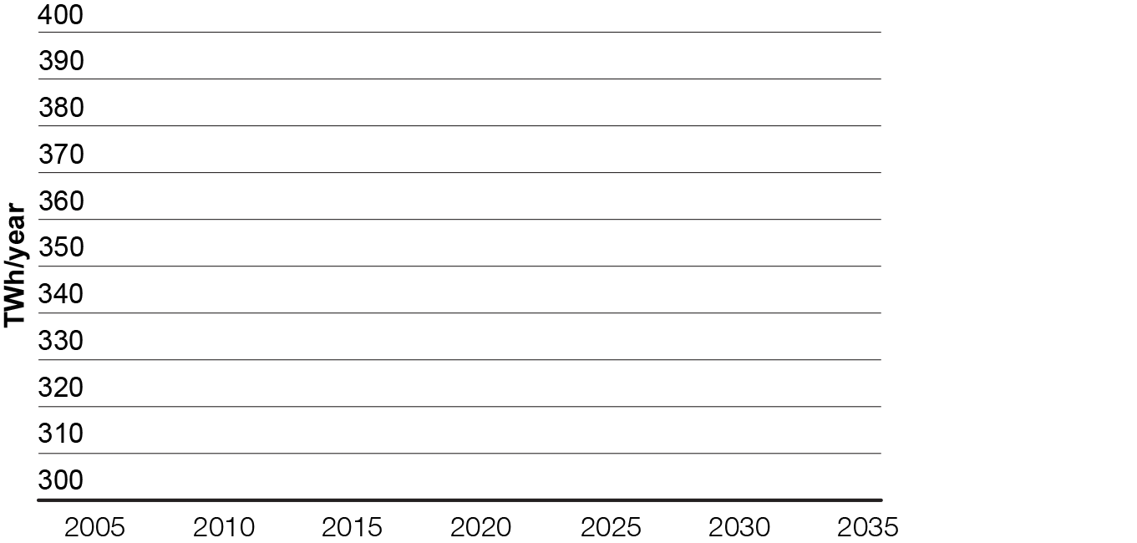
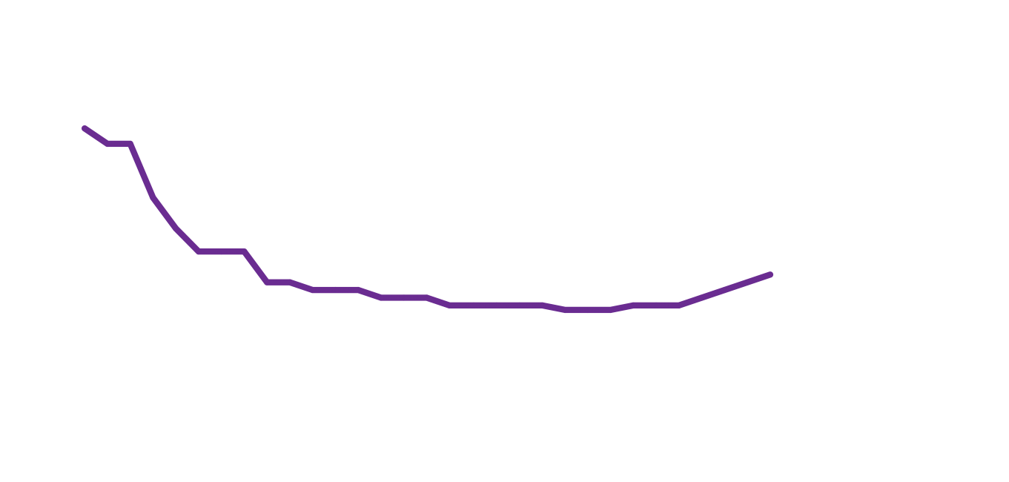

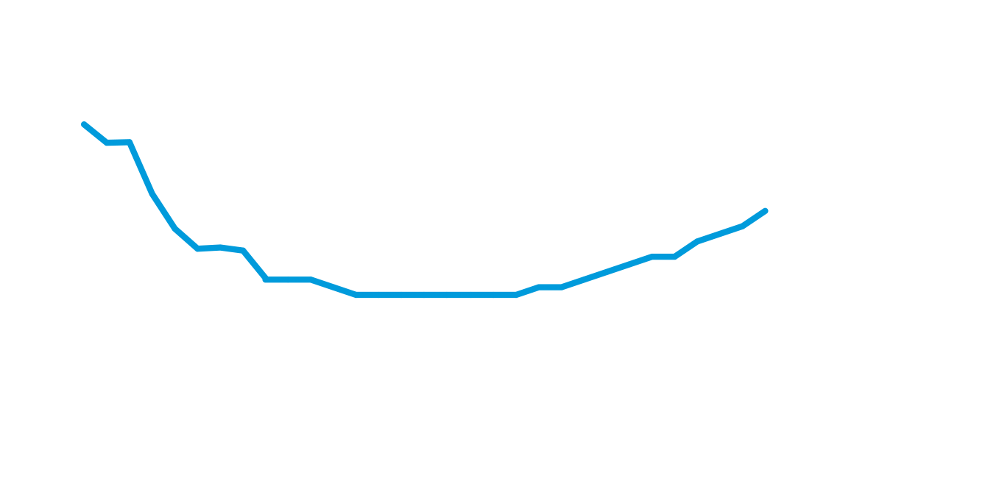


Power demand
Similar demand levels until the early 2020s, then green ambition and prosperity drive the differences
The start of the electrification of heat and transport drives demand into
the future
Notes:
Again, like in gas the last few years saw a fall in demand due to the recession
In a No Progression world the low green ambition and low prosperity mean we have a low push for energy efficiency and less demand from the Industrial and Commercial sector. Also we don’t move to electrify heating technologies. These combine to a slow drift down in demand, then a pick up as the number of homes increases over time.
In a Consumer Power world, our Industrial and Commercial demand falls as gas is the cheaper fuel for heating, but in our homes we use more power for our new “quality of life” consumer goods, like air conditioning and electric vehicles. This pushes demand up ~20 TWh from today.
In a Gone Green world, the strong energy efficiency push initially drives demand down, then we see it kick up in the early 2020s as we switch to low carbon heating and electric vehicles; pushing demand up ~50 TWh from today above pervious highs. This is roughly half todays residential demand
In a Slow Progression world, the switch to low carbon heating and electric vehicles is less than in Gone Green. However there is still a push to energy efficiency, and the lower economic growth keeps down Industrial and Commercial demand, so like No Progression, there is a slow drift down in demand, then a pick up as the number of homes increases over time.

Slide 5
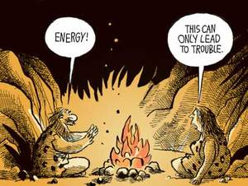
The future of residential heating
AIR
SOURCE
HEAT PUMP
GROUND
SOURCE
HEAT PUMP
GAS HEAT
PUMP
HYBRID
HEAT PUMP
FUEL CELL
BIOMASS
BOILER
MICRO
COMBINED
HEAT
Image courtesy of the Morgan Hill Times
Notes:
Today in our homes we use around 320 TWh of gas, mainly for heating – this is about the same as the total demand for electricity – the largest single sector, so what happens here is important.
Most properties have gas boilers (85%)
Some have storage heating (10%)
And the rest, have a combination of oils and solid fuels
But the future has the potential be very different as there are a plethora of new heating technologies, even today, for our homes. Some of these currently receive support and even allow us to generate our own electricity as more people look to alternative options. These include air source heat pumps, ground source heat pumps, gas heat pumps, hybrid heat pumps, fuel cells, biomass boilers and micro combined heat and fuel cells.

Slide 6


Heating in 2035
Today
Gone
Green
2035
Consumer
Power
2035
85%
61%
82%
9%
30%
13%
Notes:
Today in home we have the majority of domestic heating is gas – and what is electric is mainly Storage heating.
We see these storage heating demand being more “sticky” than last year (due to the new modelling in this area) as the heat pump fit for these buildings is not ideal (due to heating hot water systems) so we have more demand from this staying on the system for longer.
A Gone Green world there is a move to low carbon heating driven by the green ambition and the prosperity to allow higher up take of these technologies. There is also a robust support mechanism in place by around 2020. This leads to 30% of homes being heated by electricity of some form, and 60% remaining on gas.
In a Consumer Power world gas is (relatively) cheap so gas demand holds up. However it is not all gas boilers. More people (1.5 million) have micro combined heat and power (mCHP), choosing these as over heat pumps as gas is more desirable and they allow you to generate your own electricity

Slide 7
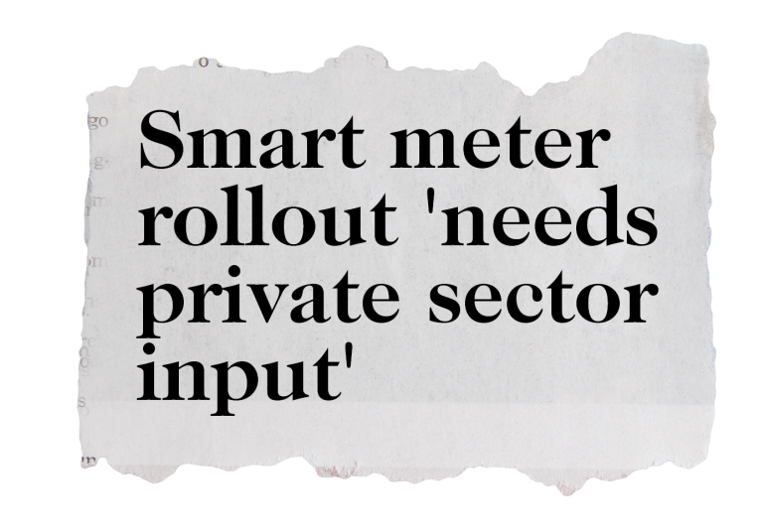

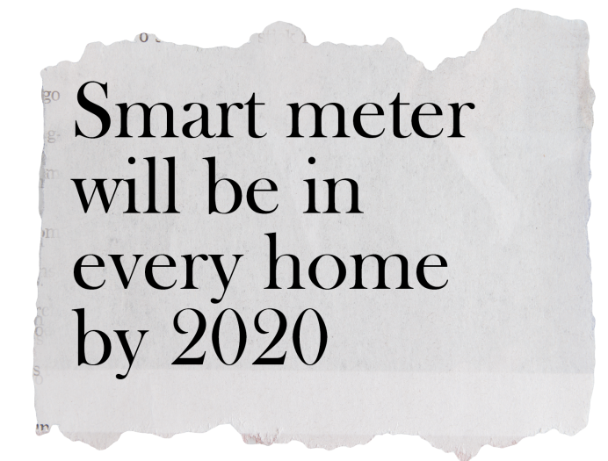
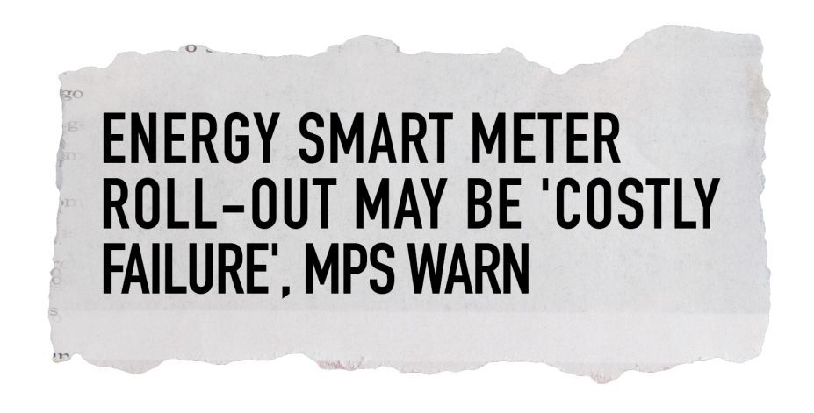
Smart meters
Notes:
Smart meter are planed to be rolled out to every home, for both gas and electricity, by 2020 – this is a challenging target and there is a great deal of uncertainty
We reflect this uncertainty in our scenarios; Gone Green rolls out smart meters by 2020, where as the other scenarios have a later role out profile, with No Progression being the slowest

Slide 8


Potential of smart
TODAY
Gone
Green
2035
Consumer
Power
2035
0M
5.3M
5.3M
0GW
1GW
3GW
Notes:
In the future, 2035, in our Gone Green and Consumer Power scenarios we have the same amount electric vehicles. Today there are around 35,000 EVs on the road. These use very little power at peak.
In 2035, in GG there will be 5.3 million on the roads (out of around 35 million in total). The power requirements for this are around 1 GW at peak
In Consumer Power there will still be 5.3 million on the roads, however the power requirements for this are around 3 GW at peak – that’s 2GW different from Gone Green (the size of a large power station).
This difference is due to different charging profiles in the two scenarios. In Consumer Power there is little incentive to change your natural behaviour (get home and plug in), while in a Gone Green world there are these incentives; people engage with their smart meters and tariffs. Additionally innovation incentivises you to move your changing away from peak. This reduction has been observed in a trials. This change could lead to saving on the supply side; reducing the need for power stations

Slide 9

Summary
Potential for new heating technologies to help hit
Carbon targets or keep today’s level of gas demand
Uncertainty surrounding smart meters, but they have the potential to help reduce need for generation
We are looking forward to your feedback on our 2015 scenarios!

