Slide 1

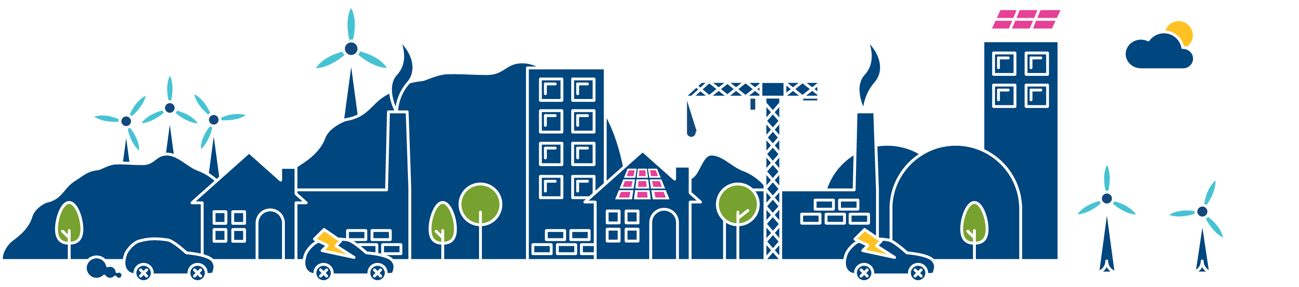
Future Energy Scenarios 2015
Operability
John West
Electricity Policy and Performance Manager, Network Strategy

Slide 2
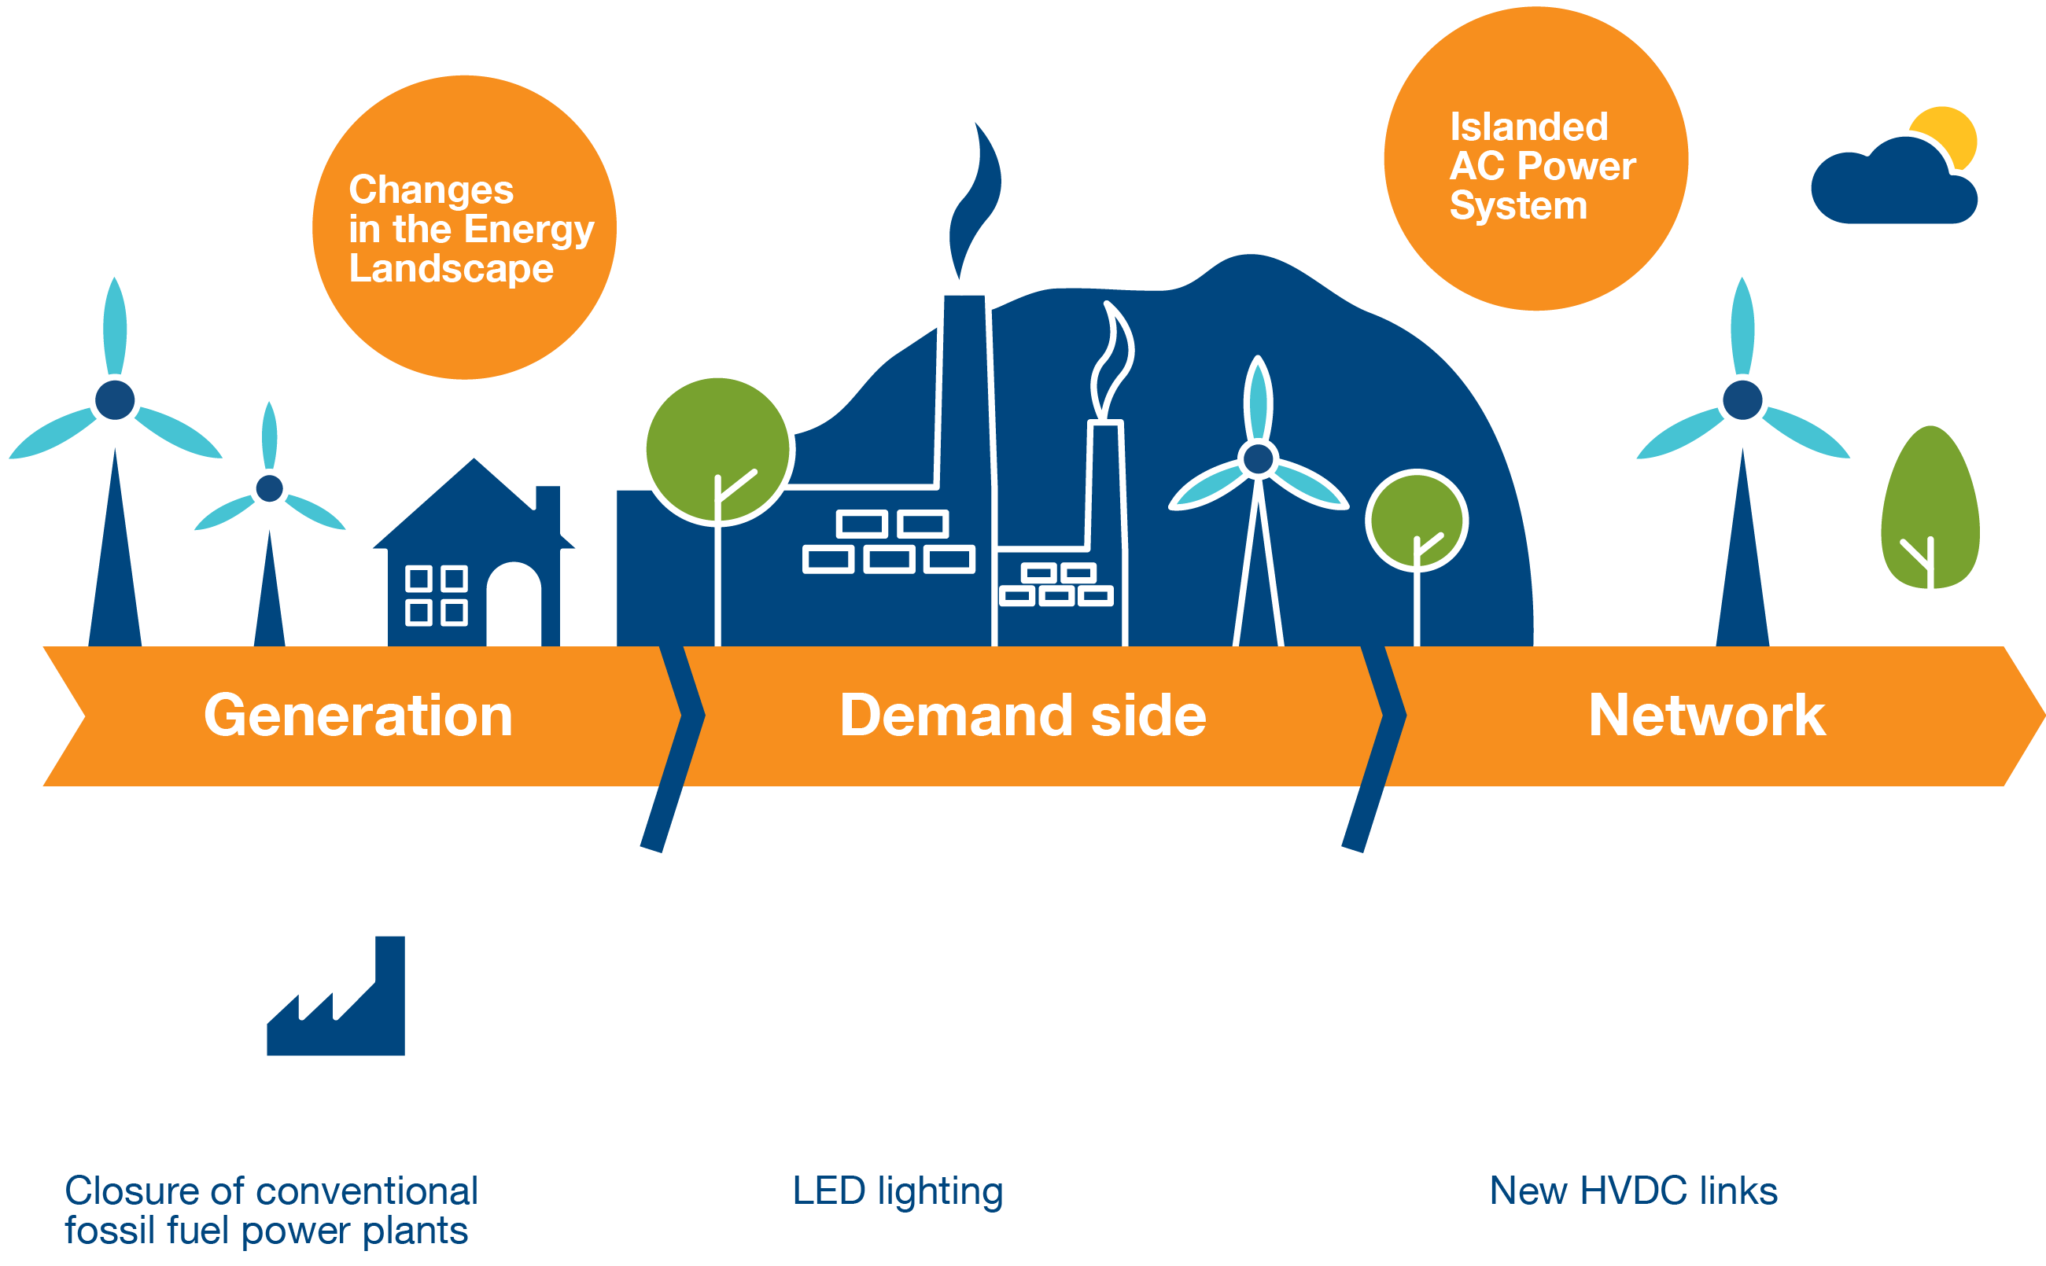
What’s happening to operability?
Notes:
In this session, I will focus on system operability. This is a new session this year and recognises the increasing challenges we face. It’s an area where we need to work more closely with industry.
Some of the changes affecting system operability are captured on this slide. Reduced levels of conventional generation, changes to demand types, the use of new technologies to provide network capacity.
System operability challenges are not new to us of course. We discussed challenges in our System Operability Framework document in 2013 and again in 2014. But some of these challenges are happening very quickly. So we want to move quickly to explore possible solutions with industry stakeholders. If we can agree code changes, develop new services, we will be able to operate with greater levels of renewables.
These changes are also happening in other networks of course so we can learn from elsewhere. We have particular challenges in Great Britain as we are an islanded AC system with (currently) limited interconnectivity. Unlike Continental Europe for example, we are not able to rely on being part of a much larger synchronous system.
Some of the challenges that we are already seeing are illustrated on the next slides.

Slide 3
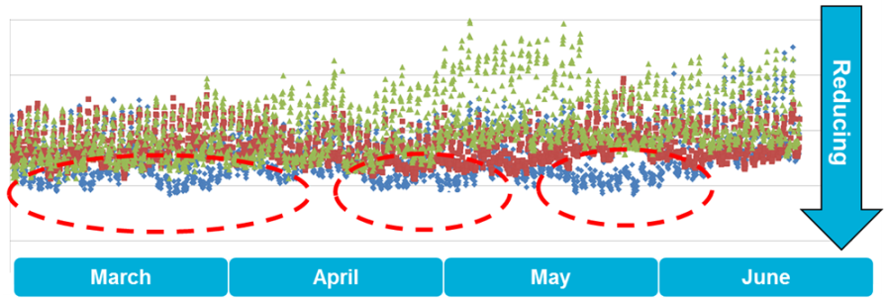
Impact of changes on operability
Falling system inertia is driving changes
400
350
System Inertia (MWs)
Reducing inertia
300
250
200
March April May June
2011
2012
2013
Notes:
First of all we are seeing falling system inertia due to the changing types of generation that are running. Inertia is measure of system strength, its robustness to sudden shocks. Traditionally, the GB system has had a lot of rotating machines that are synchronised with the electricity system and have given it a lot of inertia.
We measure system inertia in MW Seconds. The graph here shows the amount of system inertia in the GB network over the period March through to June. The different colours illustrate how the level of system inertia has fallen over the last few years. For example, the points shown in blue are for the most recent year. If you look at the trend, you can see that our measure of system inertia is falling.
Generation sources such as wind and solar PV are not synchronous in operation and don’t provide system strength in the same way as rotating machines. So the system is less stiff, less resilient to changes such as a generator or a large demand tripping.
We operate the GB network at a frequency of 50Hz, within a very tight tolerance. If something happens, a generator or an interconnector trip for example, the system frequency will move quickly. With lower system inertia, the frequency changes will tend to be greater and harder to manage. If this is not planned for, there will be wider disruptions as the frequency would move outside of design ranges and generation and other equipment would be tripped by protection systems or would be damaged.
Challenges due to lower system inertia have already required changes to how we operate. For example, we are changing protection systems on small generators so that they are not tripped by system events. Going forward, as inertia falls further, we will need to develop new services to manage frequency.

Slide 4
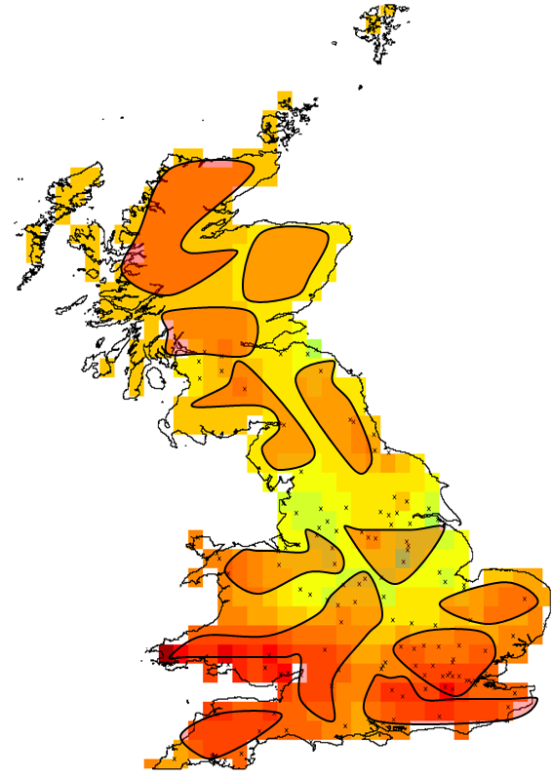
Impact of changes on operability
Managing higher voltages is driving up costs
Notes:
Another challenge that we are already seeing is Voltage Management. Like frequency, voltage is a fundamental attribute of an electrical system. It’s like the pressure in a water system and we need to manage it carefully for the system to work properly.
The equipment that makes up our transmission network is designed to operate in a narrow voltage range around either 400kV or 275kV. The voltage is managed to remain within this range (+5/-10% for 400kV). On a lightly loaded AC transmission system as we now have at times, voltage can get too high and we need to take measures to reduce it.
The picture here illustrates a snapshot of voltages on the GB transmission network during a period of light loading. The areas shown as orange or red illustrate those parts of the transmission network where the voltage is very high and is approaching operational limits.
There are a number of factors that are contributing to higher voltages on the transmission network. Changes in electricity demand such as the wide-scale use of LED lighting for example - this is more capacitive that lighting that we previously used. Also the increased use of underground cables on distribution networks and the increase in distributed generation are factors. At the moment, these factors are increasing the voltage we see on transmission network and are making it more difficult and more expensive to manage.
Voltage management is part and parcel of system operation of course but the changes we are seeing are extensive and are happening very quickly. To manage this issue we are already investing in new reactive compensation equipment and seek services from the transmission connected generation. As well as these measures, we need to find other ways to utilise generation and demand services to maintain voltages at safe levels.

Slide 5
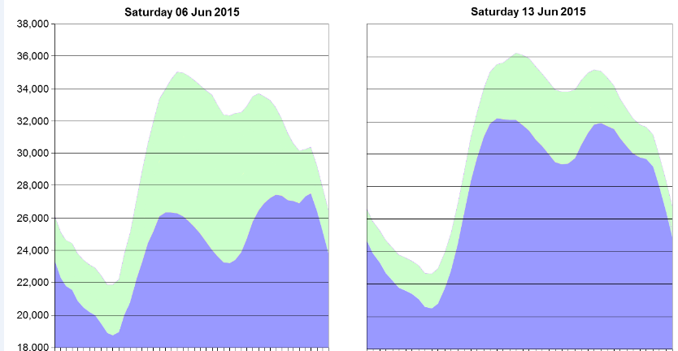
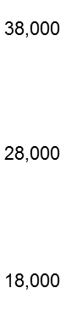
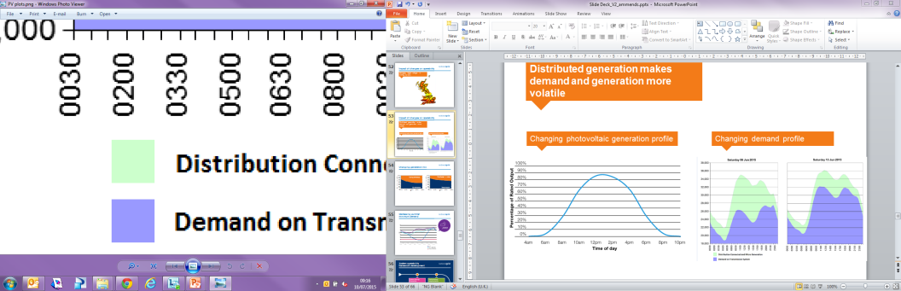
Impact of changes on operability
Distributed generation makes demand and generation more volatile
Photovoltaic generation profile
Changing demand profile
Saturday 13th June 2015
Saturday 6th June 2015
100%
75%
50%
25%
% of rated output
Time
Distributed and micro generation
Transmission demand
Notes:
A third factor is the way in which distributed generation is changing the Demand Profile we see on the transmission system. What I mean here is the net demand that is being met by generation that is directly connected to the transmission system.
To illustrate this, on the left is the output from a typical solar PV farm connected to the distribution network. The solar PV starts to generate early in the morning, increases its output in the middle of the day and drops off in the evening. Most solar PV’s are relatively small but the number of installations that we now have means that there is around 7 to 7.5GW of total solar capacity installed. So on a sunny day with an underlying demand of around 20GW, the effects of solar PV (and other distributed generation) can be very great.
This is illustrated on the second graph where two demand profiles over the same day of the week are compared. These profiles were a week apart this June. A few years ago, these profiles would have looked very similar. But now, because June 13th was sunnier than June 6th we see a very different demand profile that needs to be met by the generation directly connected to the transmission system.
One of the challenges that follow from this is accurately forecasting the load shape, and the level of transmission connected generation and system services that are needed.
Another challenge is as the load shape is more volatile day to day, and indeed through the day, we need flexible sources of generation to respond to this.

Slide 6


Changing generation mix
Consumer
Power
100%
75%
50%
25%
0%
100%
75%
50%
25%
0%
Non-synchronous generation
Distributed and micro generation
Synchronous generation
Transmission demand
Notes:
So, it is clear that there are already significant operational challenges. What I want to do next is relate these to the Future Energy Scenarios that we have looked at, and demonstrate that these operational challenges are only going to get more difficult.
Let’s start with generation. I’ve mentioned that generators that rotate in synchronism with the system help make it more stable and resilient to unplanned events. When we have less synchronous generation and more non-synchronous generation connected to the network, the system inertia reduces.
The graph on the left shows the Consumer Power 2015 scenario twenty year outlook with the relative proportions of synchronous and non-synchronous generation in the installed generation capacity. This demonstrates that our system inertia challenges are likely to increase. But this doesn’t really convey the full challenge. Because much of the non-synchronous generation is renewable and there will be long periods when the proportion of non-synchronous generation could be much greater than 50%. On a sunny day for example when much of the demand might be met by solar PV.
The graph on the right illustrates how the proportion of generation connected to distribution level voltages increases compared to generation connected at transmission voltages. By 2030 in the Consumer Power scenario for example, the level is more than twice what we have today. So those challenges around how we manage transmission connected generation and how flexible it needs to be will increase. Further, as more and more generation will be operating on the distribution system, and less on the transmission system, we will want to source the frequency and voltage management services that we need from distribution resources.

Slide 7

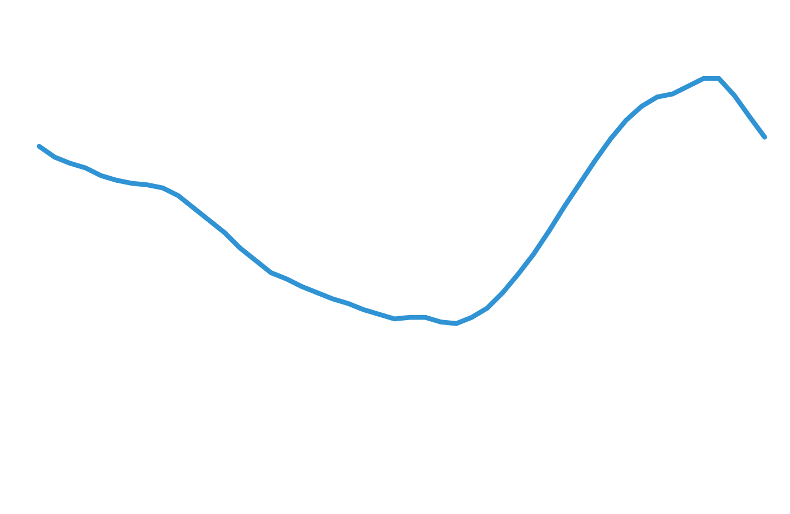
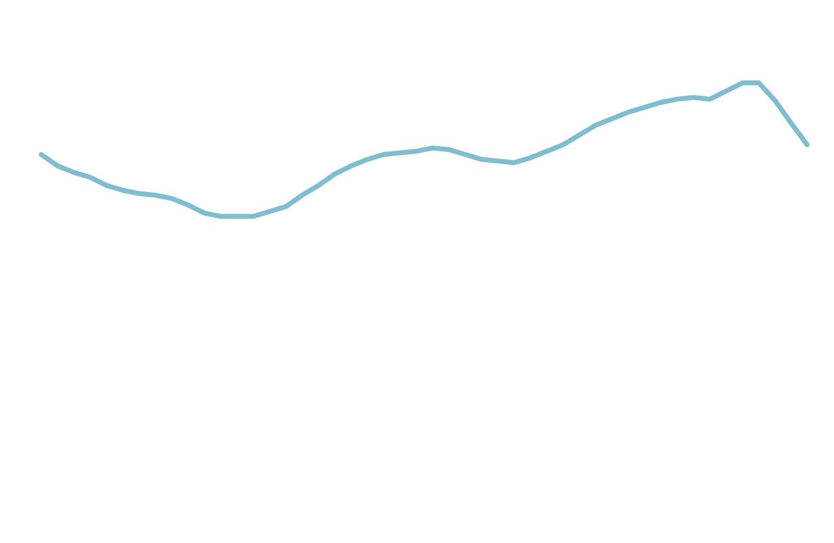
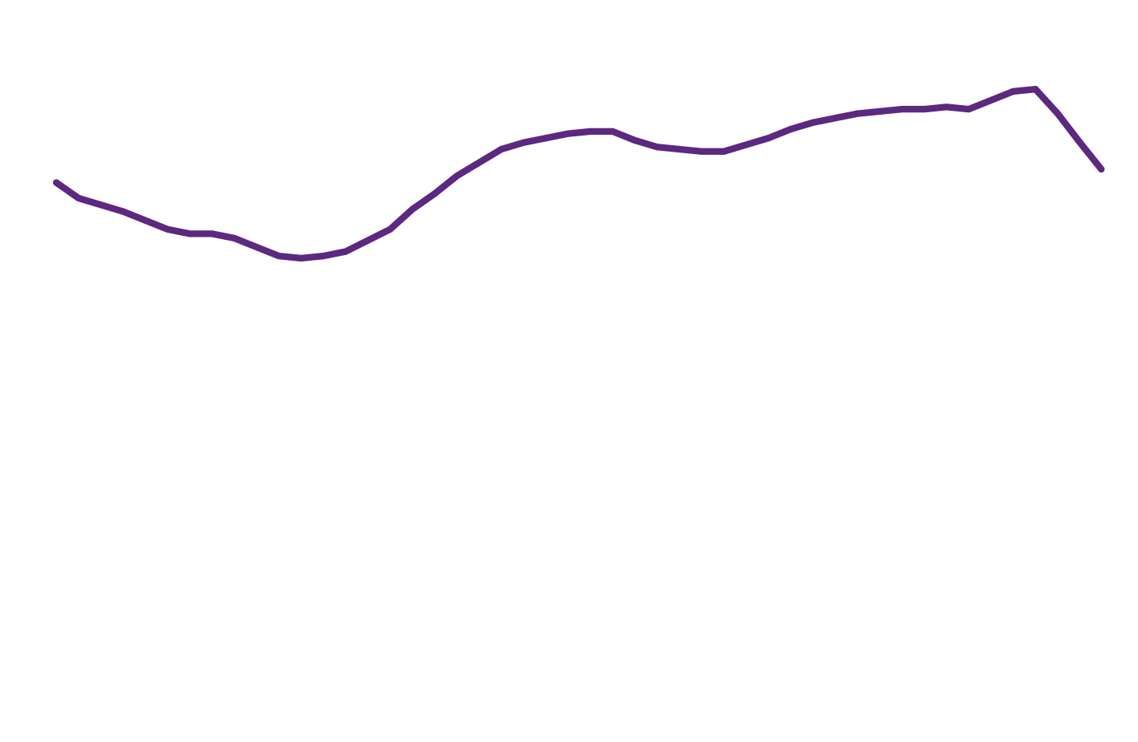
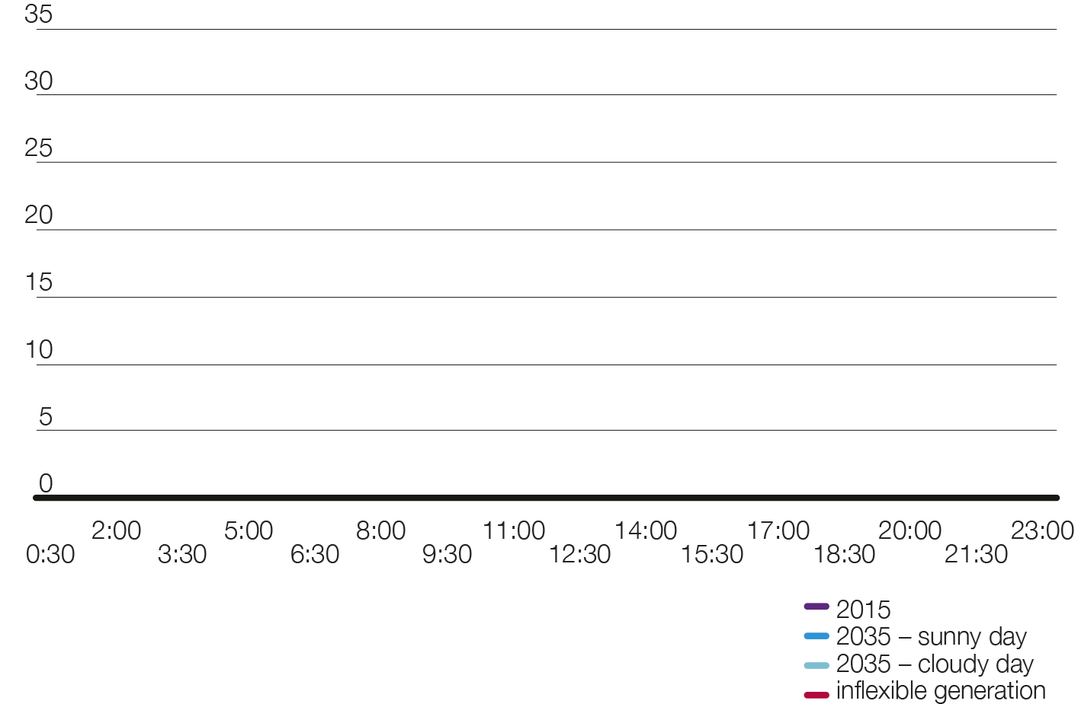


High solar impacts
system operability
Consumer
Power
Summer minimum demand
Transmission demand (GW)
Time
Notes:
If we now take a look forward at demand as seen from the transmission system, you will see our operational challenges will increase for the Future Energy Scenarios.
Over the next 20 years, we expect the minimum levels of demand to met by generators or interconnection connected to the transmission network to drop.
The graph Marcus showed earlier illustrates a transmission demand profile on a day in 2035. Traditionally, we have seen a minimum demand of around 20GW in the summer months early in the morning. As solar PV becomes more predominant, minimum demands will reduce and the time at which minimum demand occurs will change to the afternoon. By 2035, the transmission demand might be as low as 5GW at times.
So the graph shows transmission demand on the sunny day (high solar PV) dropping to around 5GW. In addition, these periods of very low demand will occur for longer.
As we will have much lower levels of transmission connected generation operating – we will need generation that is flexible and we will need to source frequency and voltage management services more widely. Having generation that is able to ramp up and down to meet this load shape will help system operation.
We are looking to innovate to find solutions to address these challenges. For example, developing greater flexibility from existing types of generation, how we use interconnectors, the development of energy storage and demand side response.

Slide 8
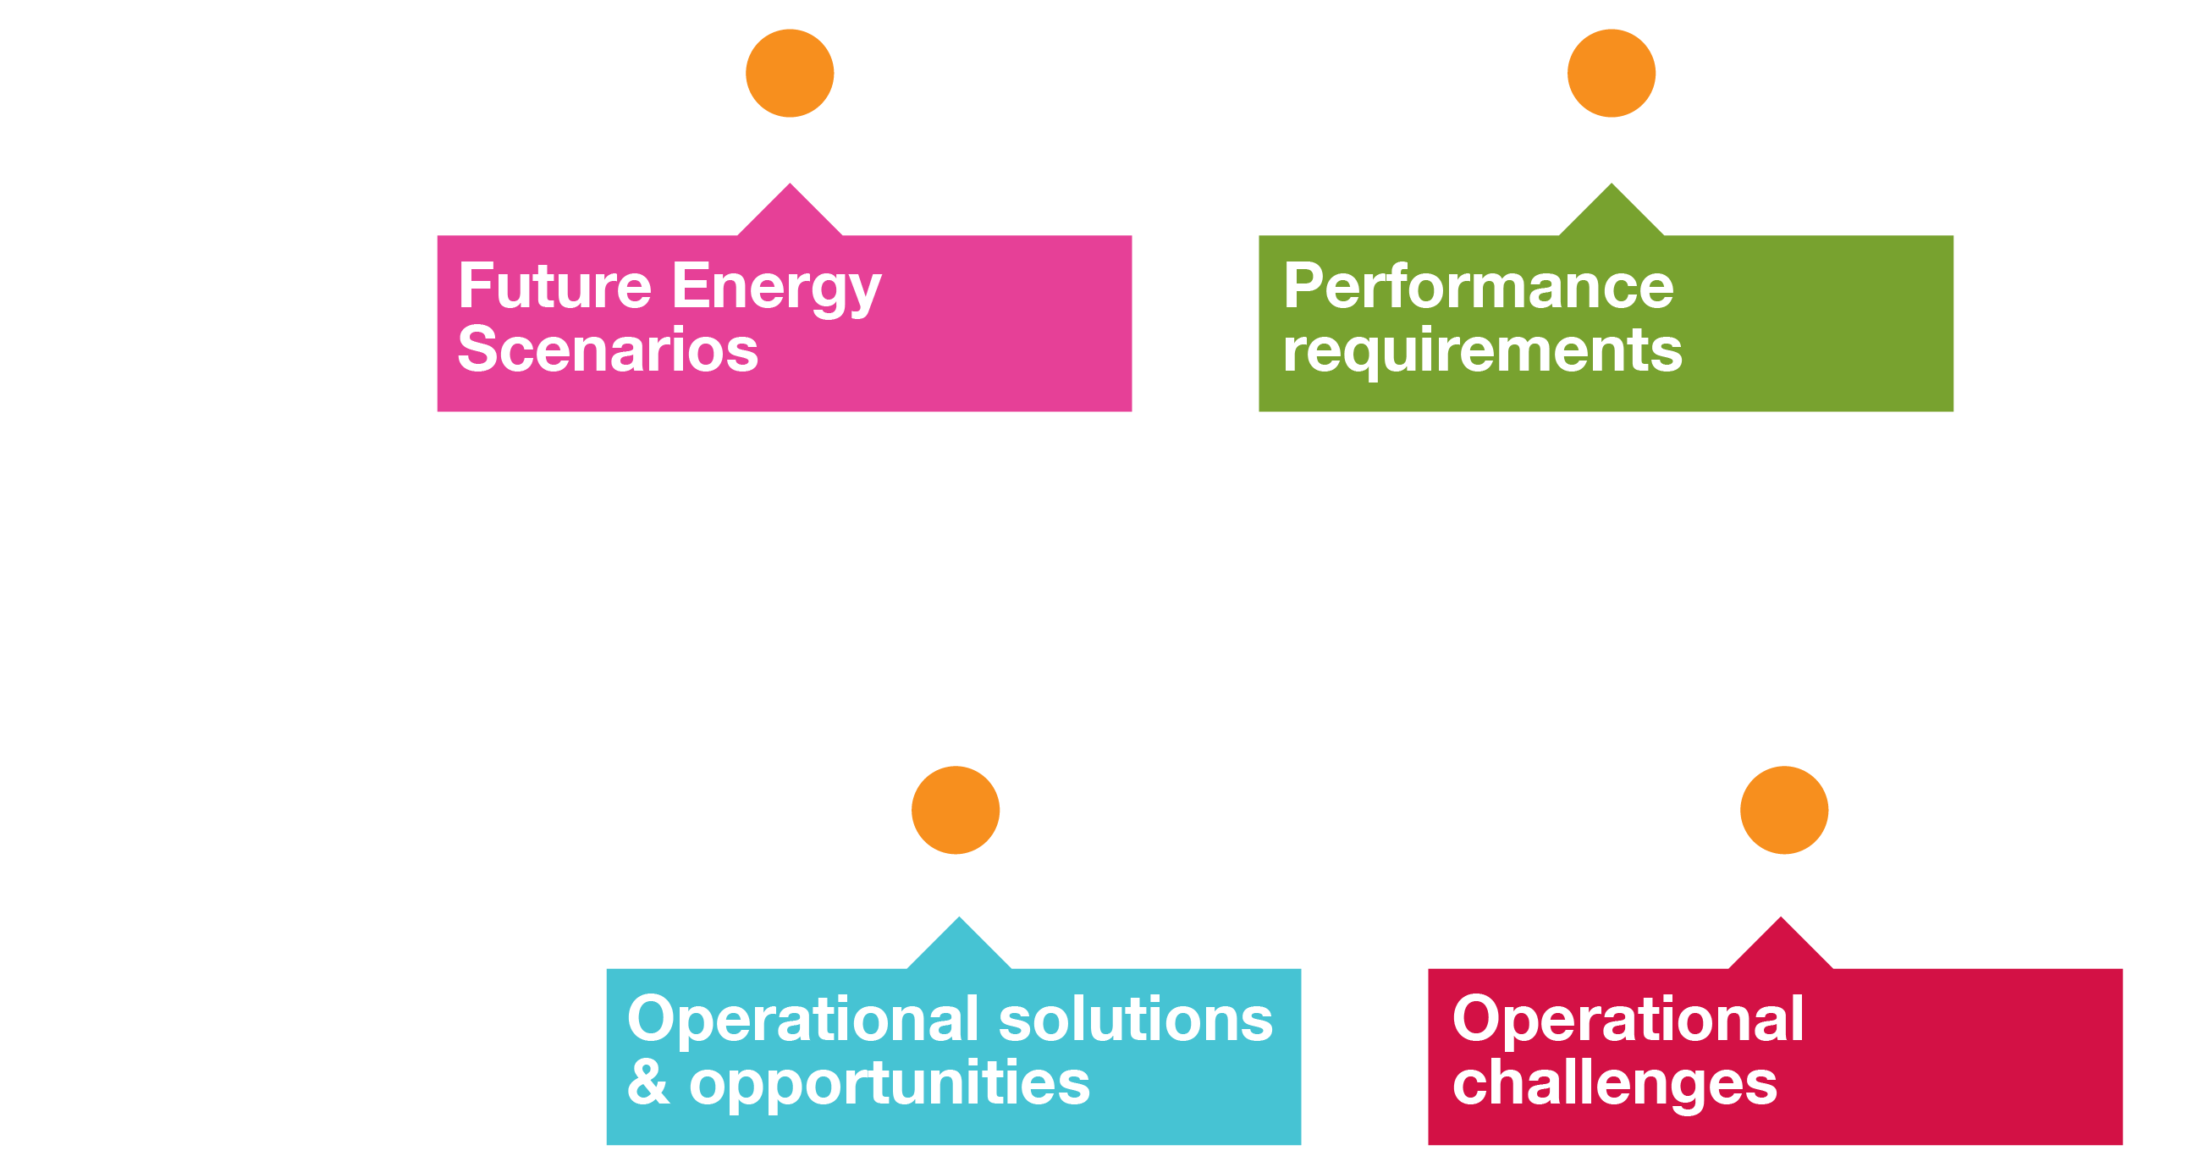
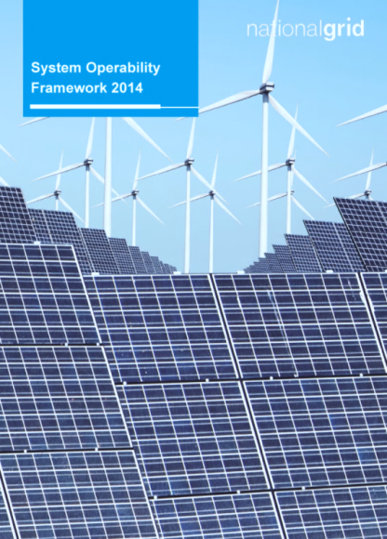
System operability
framework development
Notes:
To assess our System Operability challenges in a systematic way, we produce a System Operability Framework document each year.
The System Operability Framework (or SOF) takes the Future Energy Scenarios, studies them in detail and considers all of the possible effects on the operability of the system. It highlights where there are new opportunities for operational services and SMART grid technologies.
The SOF follows behind the Future Electricity Scenarios of course and it will be a few months before we have competed the analysis using this year’s scenarios.
The framework is designed in such a way that studies of the topics provide an understanding of when, where and under which scenarios they start to become a challenge as well as the lead-times for developing new services/solutions.
The next few slides explain the work that we do to produce the System Operability Framework – the Topics, the Timeline and the Solutions.

Slide 9
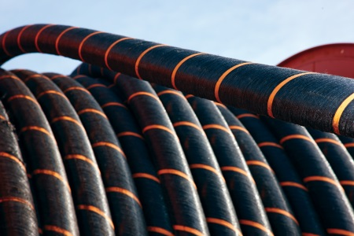
How does SOF work?
Timeline
Solutions
Topics
Timeline
Solutions
System Inertia
Short Circuit Level
Conventional Generation Closure
Distributed Generation
Heating & Transportation
New Nuclear Plant
Reduced Controllability
Reliance on External Networks
More HVDC Links
Notes:
The System Operability Framework covers a wide range of factors that will impact system operation and the technical challenges that these factors give rise to.
For example, we consider the impacts of lower system inertia. How to manage more rapid frequency changes, how to contain and recover system frequency in the event of a system problem.
We face many other technical challenges. Very low system strength (short circuit levels) has implications for protection systems, voltage management and how we operate HVDC links. We need to be confident that protection systems and HVDC links will be able to operate on much weaker systems going forward.
As well as changes linked to changing generation and demand, the SOF also considers challenges arising from the use of new technology on the transmission network itself.
This year, new topics include network control with high levels of distributed generation. We are assessing the impact of having large volumes of generation that is not visible or accessible to the system operator. More than last year, we are taking a whole network perspective, transmission and distribution, as we think about challenges and solutions.
Given the higher levels of interconnection, we may become increasingly reliant on HVDC links and on the external networks that we are linked to. As well as HVDC Technology risks, there will be other impacts such as common mode failures that could lead to large-scale outages or incidents. How incidents on the Continental Europe system impact us for example.
All of our Future Energy Scenarios include large new nuclear developments. The new nuclear units will be larger than we have at present and we will need to work out what this means in an increasingly non-synchronous system with more volatile demand and transmission flow.

Slide 10
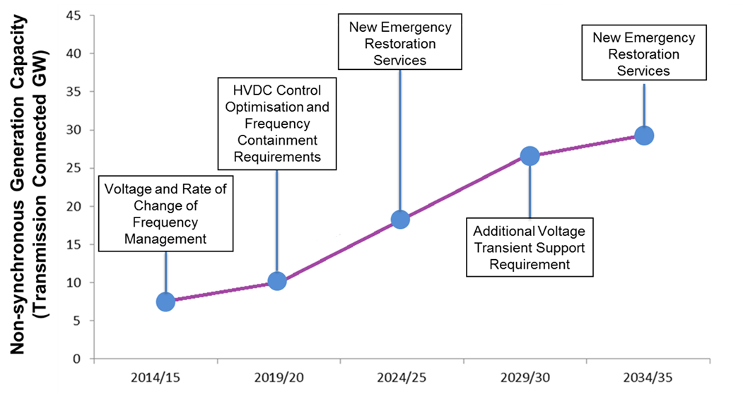
How does SOF work?
Topics
Solutions
Topics
Timeline
Solutions
Notes:
Within the System Operability Framework, we assess and provide an indication of when operation problems will arise.
For example, this slide shows the timing of issues against last year’s Slow Progression scenario. Some of the issues such as voltage management and rate of change of frequency are already evident and others such as how we would restore parts of the network in the event a widespread loss of demand will bite later.

Slide 11
How does SOF work?
Topics
Solutions
Topics
Timeline
Timeline
Solutions achieved through engagement
New Frequency Services
New Voltage Services
Demand Side Response
Innovation Opportunities
Synchronous compensation
Distribution System Operator
Technical Code Changes
Notes:
A key element of the SOF and the one where we need most help from industry stakeholders is taking forward the solutions to the operational challenges that we identify.
This slide illustrates the range of solutions that could help address operability challenges. These might include new services such as faster frequency response, synchronous compensation to support voltage or technical code changes to ensure that new generation is more flexible and is capable of providing services.
There will also be opportunities to take forward innovation projects such as the Smart Frequency Control project we are running with a number of partners.

Slide 12
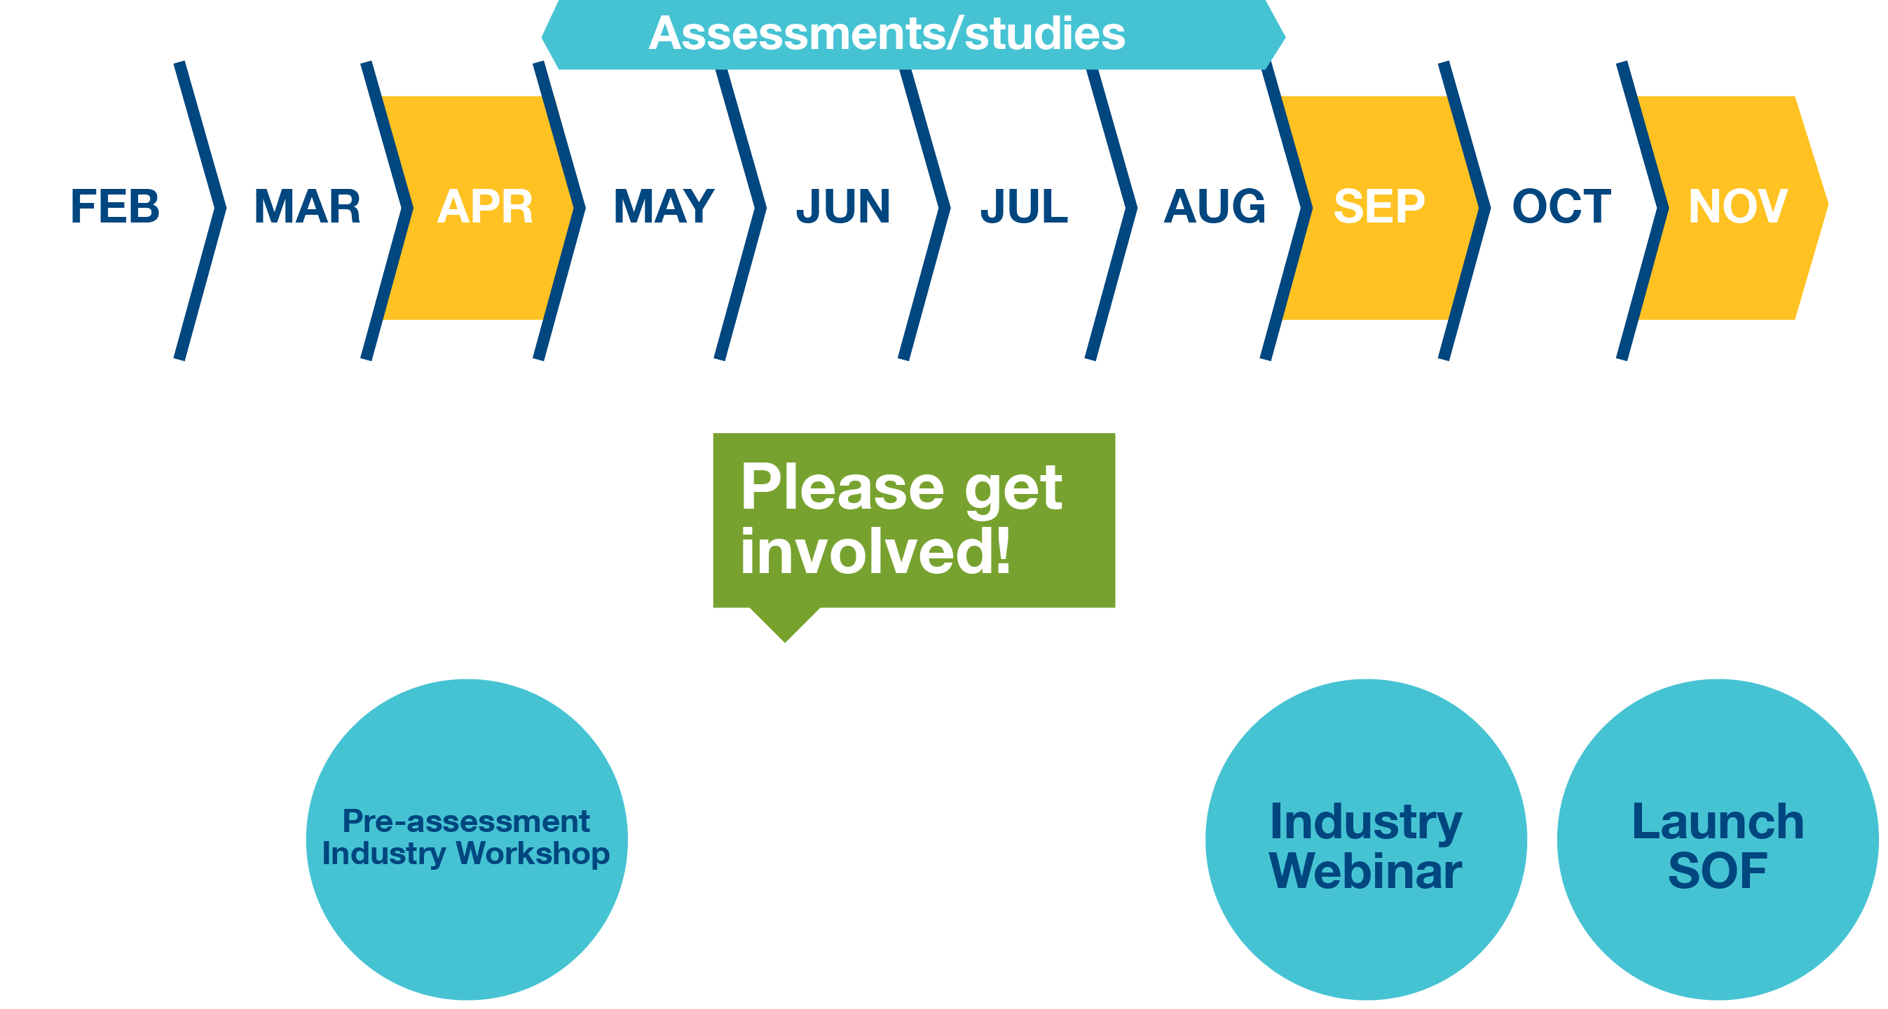
SOF development timeline
Notes:
This is the programme for this year’s System Operability Framework.
In April, around 70 stakeholders attended an industry workshop to help weigh up the key challenges.
We are now doing the analysis and power system study work that underpins our assessment of the FES scenarios.
And we will do further engagement with industry before publishing the SOF in November. This engagement will take place though a series of industry webinairs. Rather than try to cover everything at one workshop, each webinair will be focussed on a particular set of challenges and potential solutions. These webinairs will begin in early September. If you would like to be involved, just let us know at the Expo this afternoon.

Slide 13
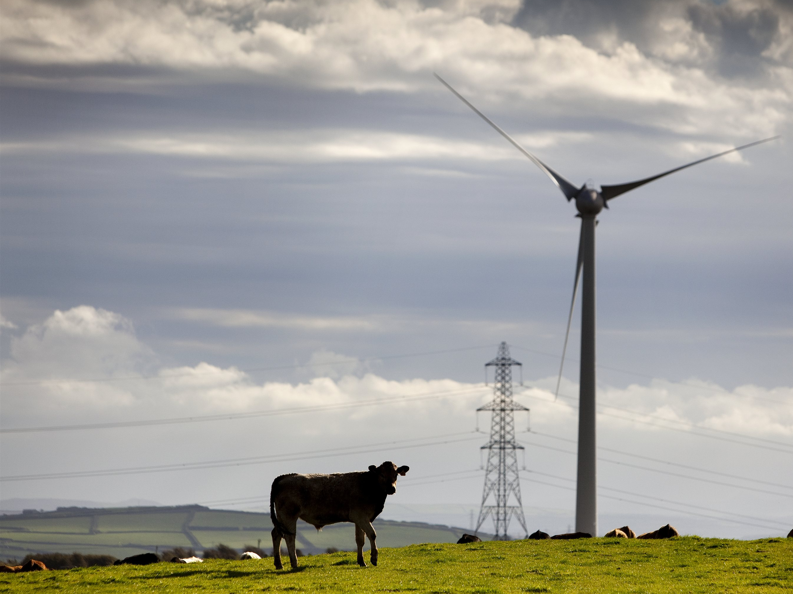
SOF Summary
Major changes are occurring in the GB energy
landscape
There are significant challenges for whole system operation
There is an opportunity for market and technical solutions, get involved by contacting us at:
box.transmission.SOF@nationalgrid.com

Slide 14
Future Energy Scenarios 2015
Summary
Roisin Quinn
Head, Energy Strategy and Policy

