Slide 1


Future Energy Scenarios 2015
Supply
Marcus Stewart
Demand and Supply Manager

Slide 2



Changes from last year
Notes:
In world of increasing uncertainty, we have some certainty for a change, at least in the near term.
First round of Capacity Market Results has helped firm up our scenarios for 2018/19
The EMR round one contracts for difference included; again giving us some certainty between now and the early 2020’s regarding renewable generation
We have refined and improved our generator economic model to build more of an understanding of trade offs between technologies
There has also been a general election; giving some policy agenda certainty (such as changes in onshore wind and promotion of shale)

Slide 3

The generation mix is shifting
Notes:
We are witnessing a shift in the generation mix:
Since last year there has be a reduction of 2GW of thermal plant due to capacity reductions and mothballing.
The amount of smaller distributed generation is set to increase:
There are basically 2 categories:
solar connecting very quick with 2GW solar deployed in Q1 2015 in a dash for ROCs before that funding closes. (7.3 GW in total by May 2015 DECC)
And peaking plant, 800MW was successful in the Capacity Mechanism auction, displacing existing and new build large plant.
The development of large (gas) plant has reduced. This is reflected by only having 2 new build CCGT plant in our scenarios to 2020

Slide 4

Narrow margins set to continue, tools are in place
Notes:
These changes have the potential to narrow security of supply margins until the Capacity Mechanism comes into effect in 2018/19.
Our scenarios focus on the next 20 years and we target 3 hours Loss of load expectation as the security standard across all of them.
LOLE is not lights going out – but number of hours on average when demand may exceed supply and the SO will need to take an additional balancing action.
Over the long term the capacity market is assumed to deliver this and this is a cornerstone of our scenarios. In the near term the LOLE may vary away from 3 before any planned intervention.
For the coming winter we expect margins to narrow slightly compared to last winter and as such NG has procured 2.5GW of balancing services based on our latest scenarios and sensitivities around them.
Between this winter and winter 2018/19 the approach for managing margins will be reviewed and consulted on through our annual Winter Consultation Outlook process.

Slide 5
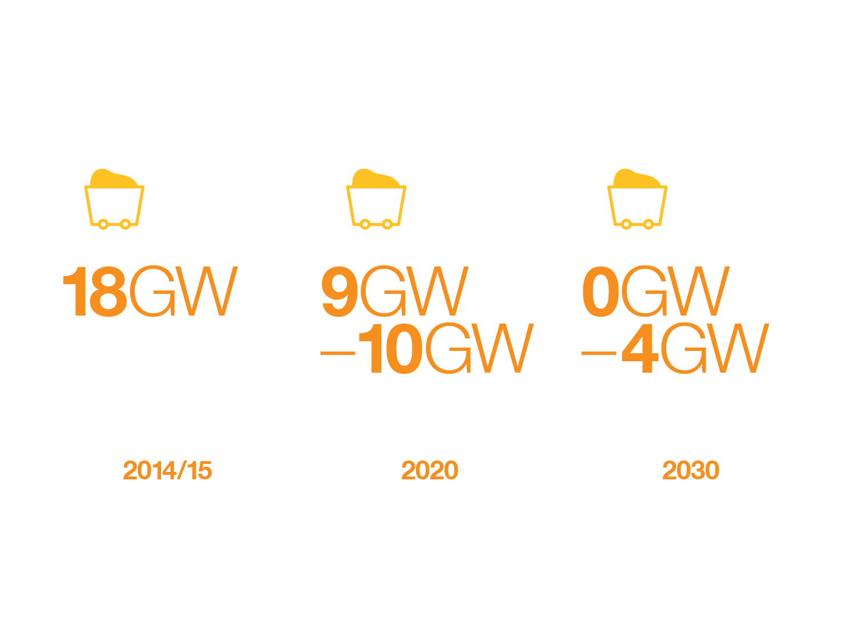
Coal declines due to environmental legislation
*
* CCS in Gone Green, conventional coal in No Progression
Notes:
Coal is set to decline due to environmental legislation
We expect the coal fleet to be halved by 2020, and with most plant closing between 2020 and 2030
We have a small amount (4GW) remaining in 2030 in our No Progression scenario and CCS coal features in Gone Green in 2030

Slide 6
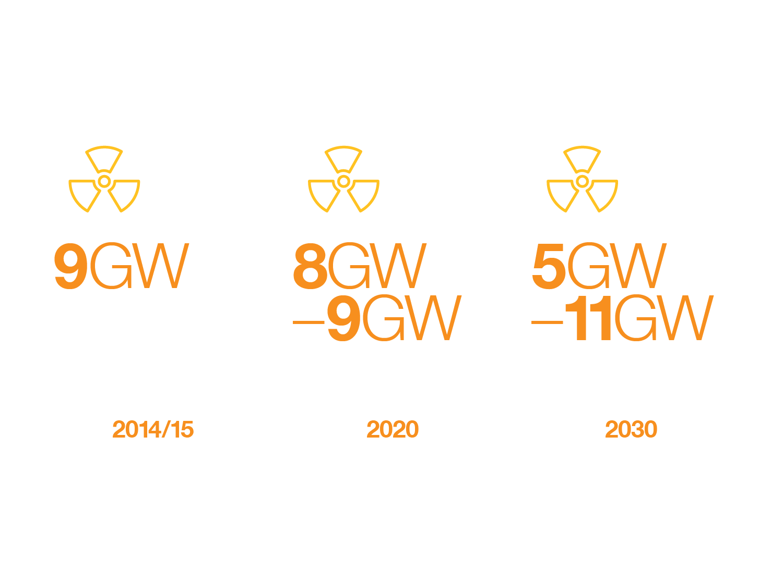
Existing nuclear declines,
new plants post 2024
Notes:
We have 9GW of nuclear today and we expect this to be largely unchanged by 2020.
We have used known decommissioning plans and life extensions to profile the decommissioning of existing plant. There are some minor differences across the scenarios to stress the network
The first new nuclear plant comes on line in the mid 2020’s and in Gone Green there are eventually 4 new plants by the end of the scenario period, we have flexed the number across the other scenarios to reflect the long term uncertainty over nuclear plants.

Slide 7
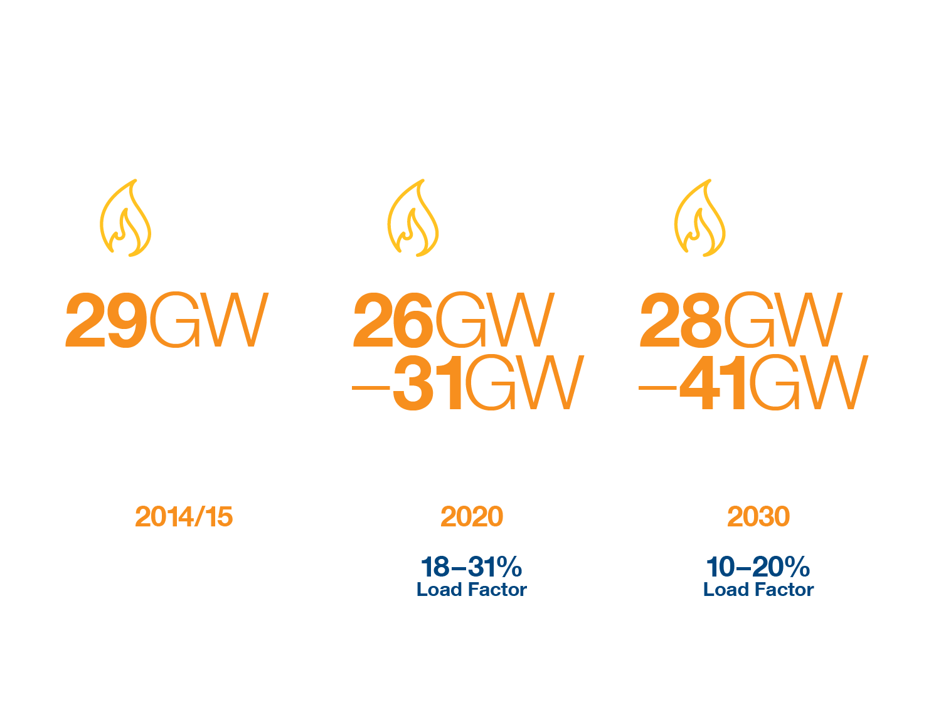
Gas important part of the mix
but economics look challenging…
Notes:
By 2020 the amount of gas is similar to today with the some variability due to different views on closures across the scenarios.
In No Progression it remains the largest source of generation capacity, whereas in Gone Green it reduces, being displaced by renewables and interconnectors. This leads to quite a variation across the scenarios by 2030.
However, the big story is the change in operating patterns and load factors. Due to increased competition from renewables and interconnectors load factors are likely to fall across all scenarios but particularly in the greener ones down to as low as 18% in 2020.
By 2030 this is even lower, down to 10% but even in No Progression which is a high gas scenario that is only 20%.

Slide 8
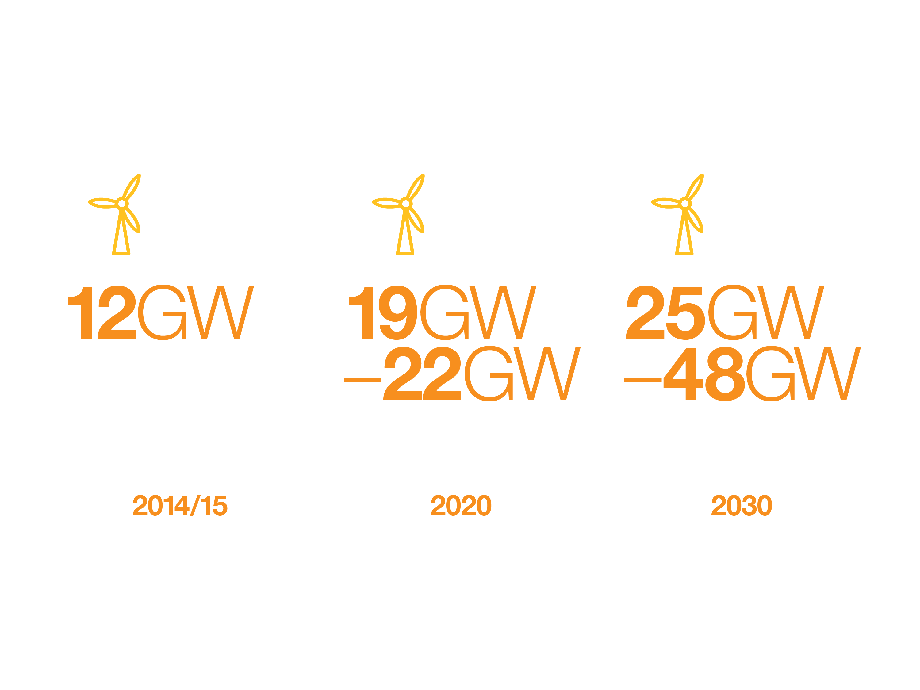
Wind capacity to at
least double by 2030
Notes:
Wind generation grows in all scenarios
In 2020 the range is similar across all 4 scenarios due to certainty of Round 1 CFD
By 2030 there is a big variance as scenario assumptions kick in
Most growth post 2020 is in Offshore wind.
48GW of wind generation in Gone Green in 2030; this alters how network will operate

Slide 9
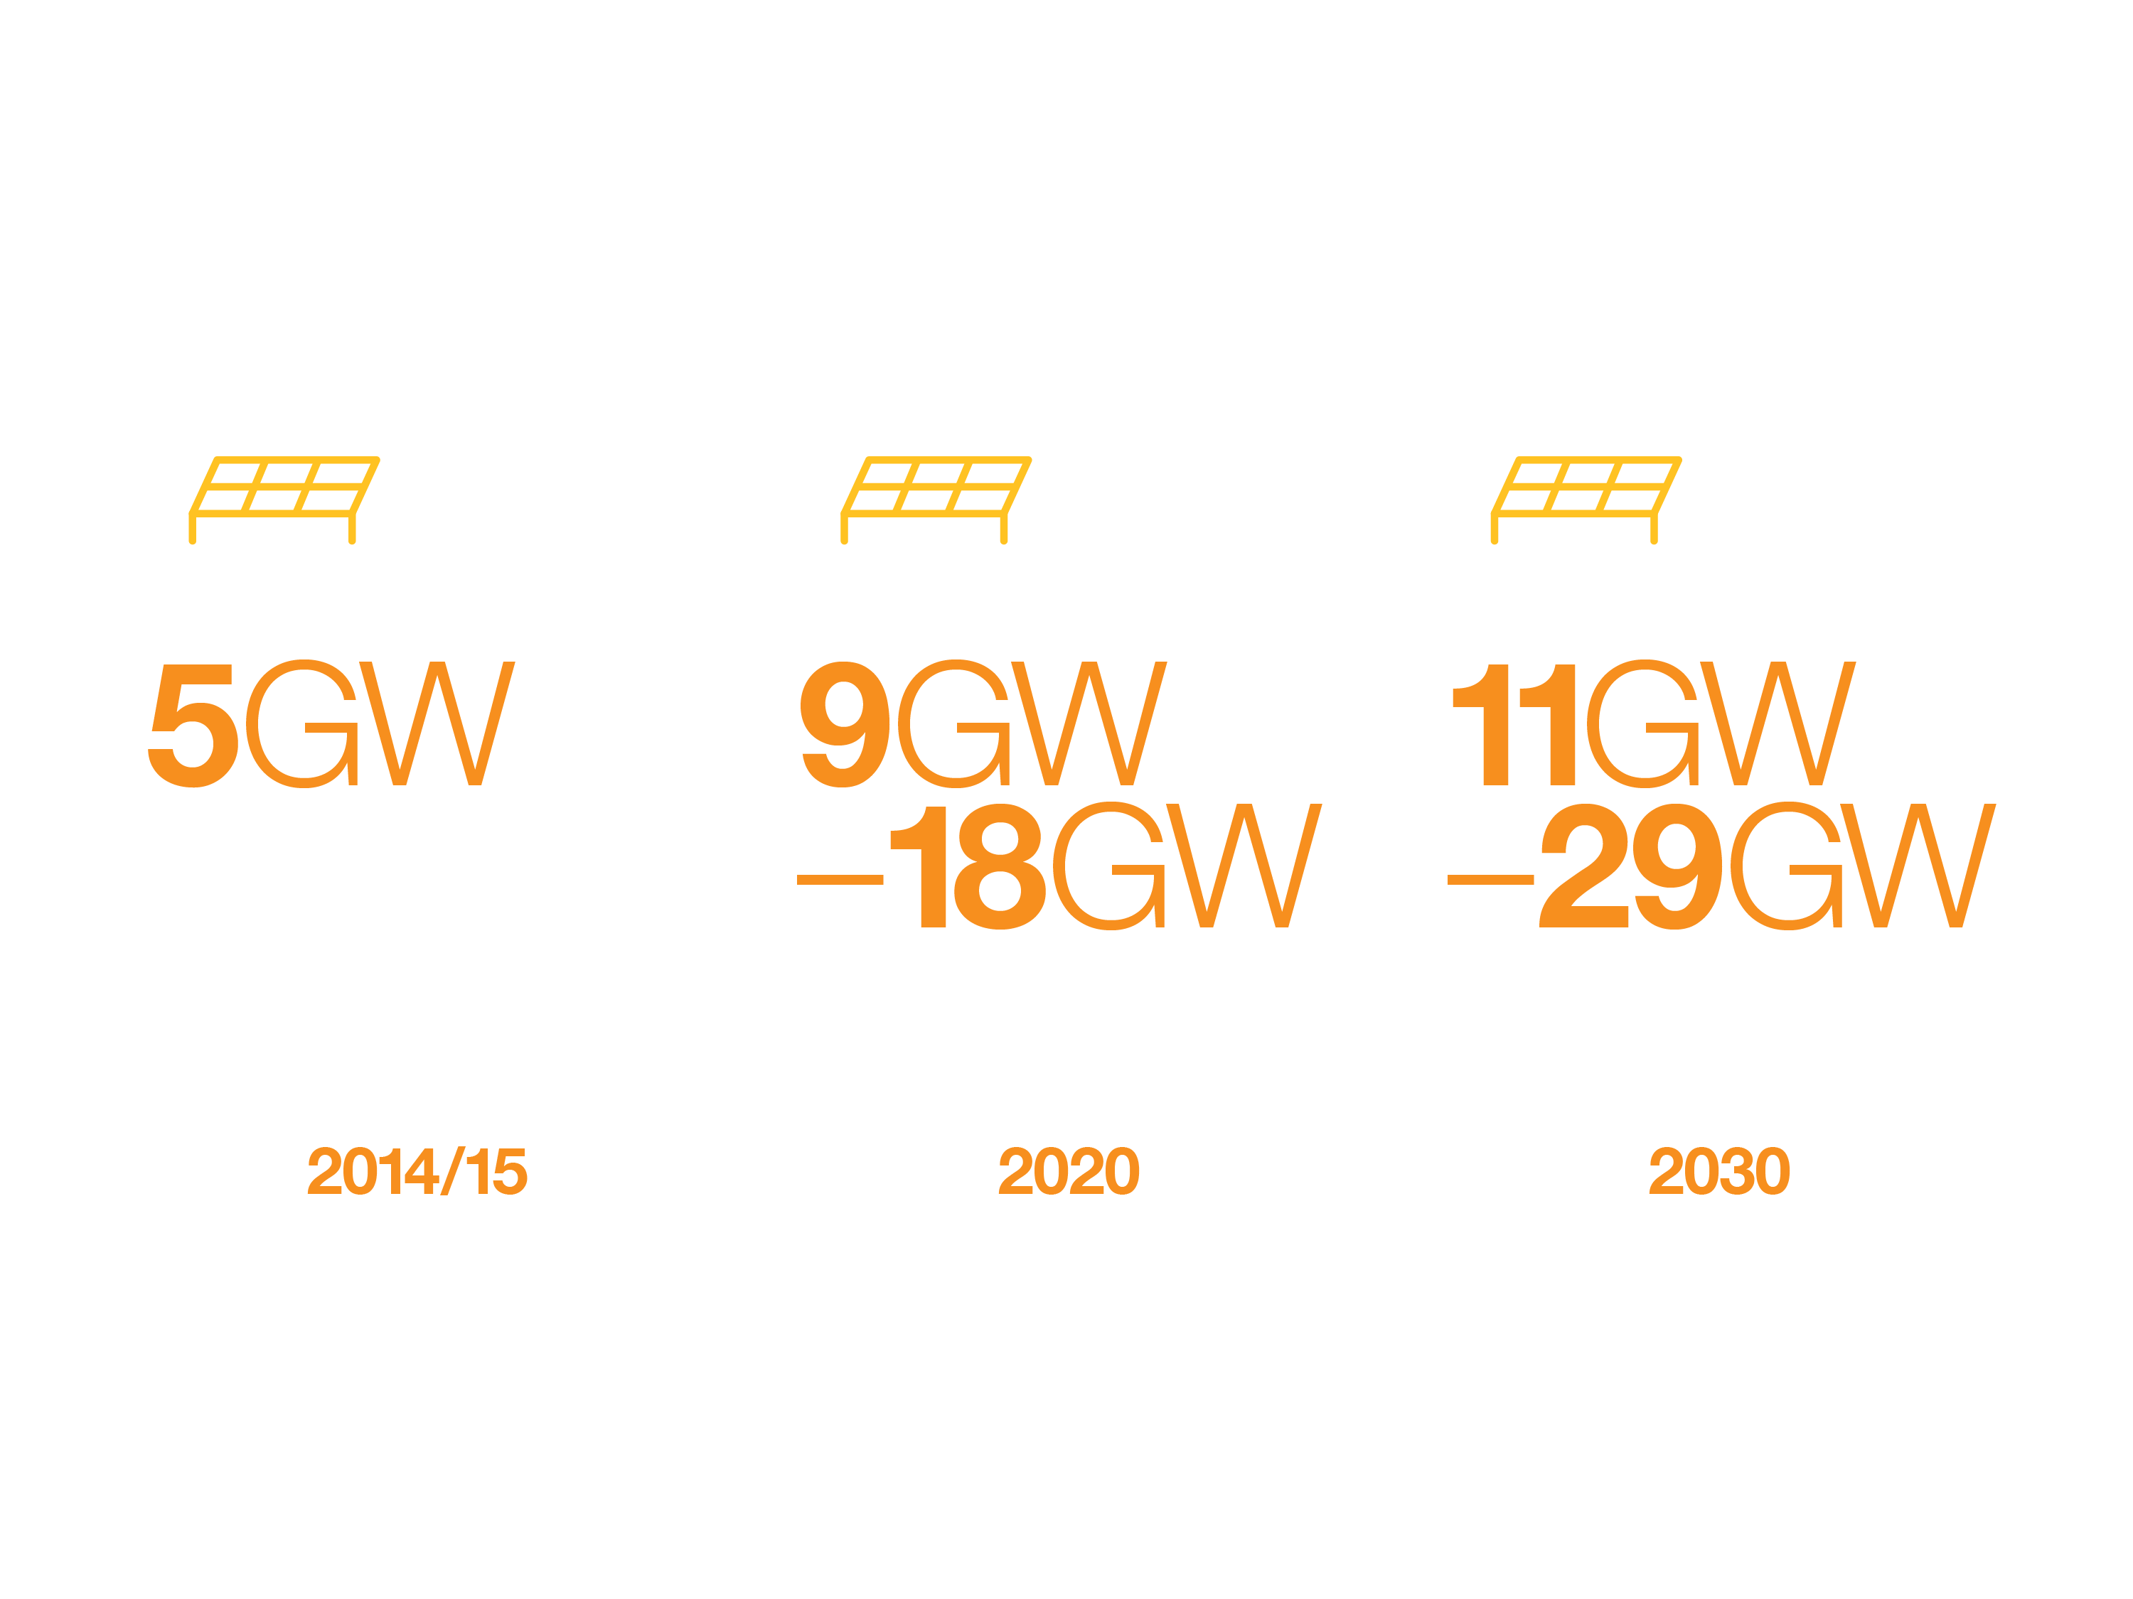
Significant solar growth
Notes:
We have seen rapid growth in solar PV in the last 2 years
Last year there was 5GW. This year around 7GW to 7.5GW believed to be connected. It has the potential to grow quickly due to the speed of construction and planning.
There is also a government strategy for industrial and commercial rooftops which is likely to see sustained growth
Additionally, costs are falling to potentially cheaper than a new CCGT; £70/MWh
Our high solar case is Consumer Power where the focus is on more decentralised energy

Slide 10

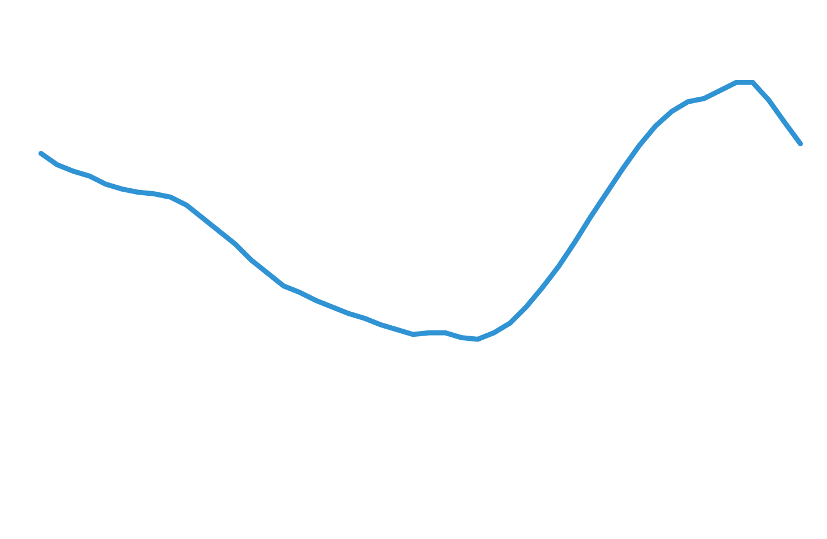


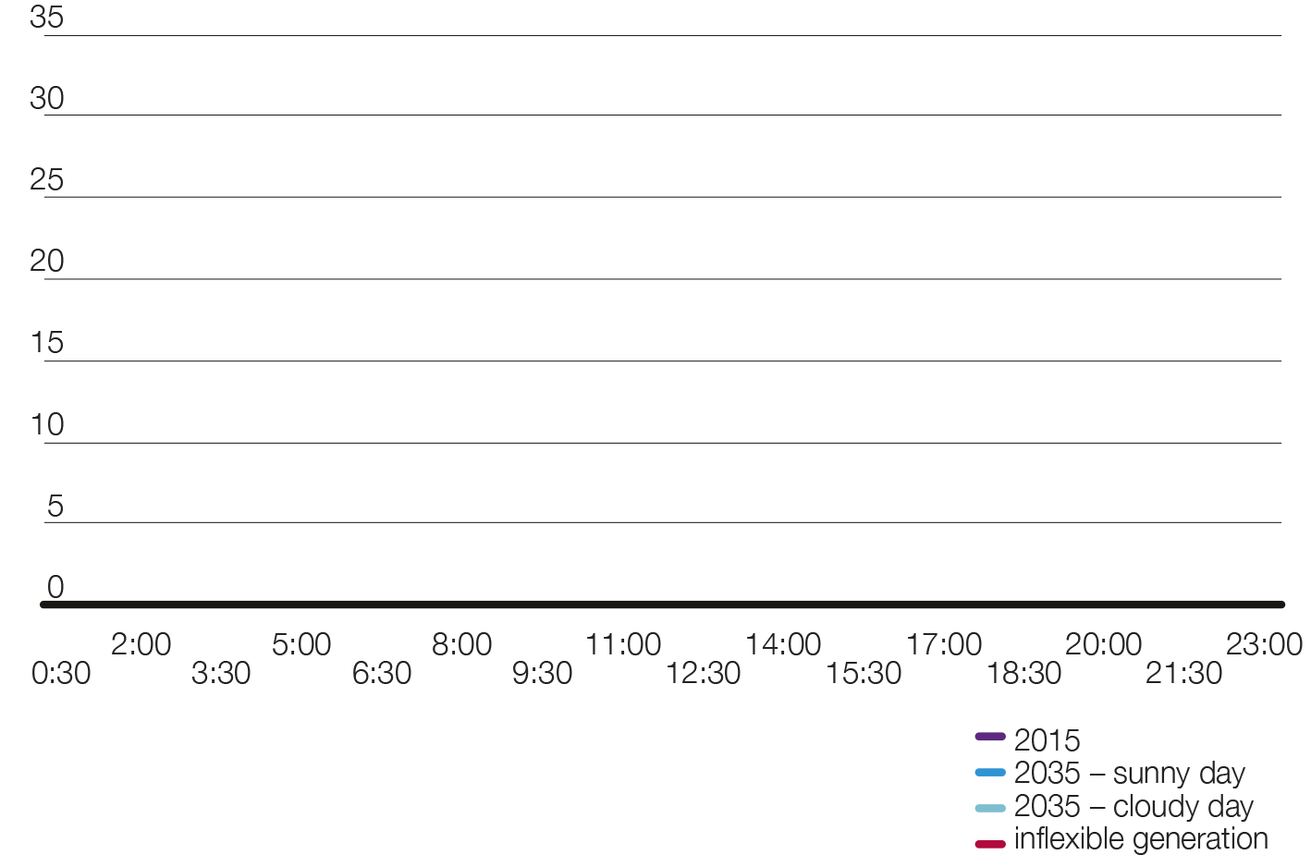


High solar impacts
system operability
Consumer
Power
Summer minimum demand
Transmission demand (GW)
Time
Notes:
In Consumer Power by 2035 there could be 30GW of solar connected to the distribution networks either solar parks or rooftops.
This gives rise to two potential operability challenges:
On a summers day the output could vary by 15-20 GW given the cloud condition; requiring accurate forecasting and reserve planning .
In sunny conditions the amount of PV output could bring the demand on the Transmission system to as low as 5GW. This is the minimum level we would expect inflexible generation to be able to run. So innovative tools and approaches will be required to manage the situation. This could include greater flexibility from existing generation and demand, energy storage, new balancing products and greater use of interconnection.

Slide 11
GB is a net electricity importer in three of the four scenarios
2030 Capacity
11GW – 18GW
Annual interconnector flows
Notes:
The introduction of Ofgem’s cap and floor regime and aspirational EU interconnection targets, plus the expected increase in intermittent generation would appear to strengthen the need case for interconnector projects and we expect a number to go live within the FES time frames with 2030 capacity ranging from 9.8 GW in No Progression to 17.7 GW in Gone Green.
GB is a net importer in all scenarios until 2030
We are developing our modelling, and we have assessed the potential flows and network constraints model nodes for each connected countries, using price assumption price assumption across each year
We are in the process of developing a Pan European model which will be used in future analysis
The key conclusions indicate that GB is a net importer (we import more than we export) in all scenarios except Gone Green which exports in the 2030’s due the large amount of wind generation.

Slide 12

Activity in the last 12 months
Notes:
The last 12 months have been interesting for the UK gas supply industry
The fall in the oil price would have been expected to impact long term production forecasts for UKCS. But it has little impact, primarily as we have come off the back of a record investment year for the UKCS. Around £15bn of capital investment has been invested in the UKCS, and the longer term view from stakeholders and industry projections is that prices will recover. Consequently UKCS production peaks in 2018 across all scenarios before going back into decline as seen in recent years.
There has also been a record year in biomethane projects with 30 sites connected up from 5 last year. We have increased our volume assumptions to reflect this, but even with the growth seen this year we only expect to see around 4bcm by 2035. This is 10% of Gone Green gas supply.
The other home grown gas source that has been in the news is shale gas. We have seen recent renewed support for shale gas, however no projects have gained planning consent yet. We highlight in the document the 9 key steps that would need to happen to achieve our high shale gas case by 2030. So far step one (achieve planning consent in the NW) is yet to be met.
Due to the uncertainty around Shale Gas we have included it in 2 of the 4 scenarios; Consumer Power and No Progression.

Slide 13
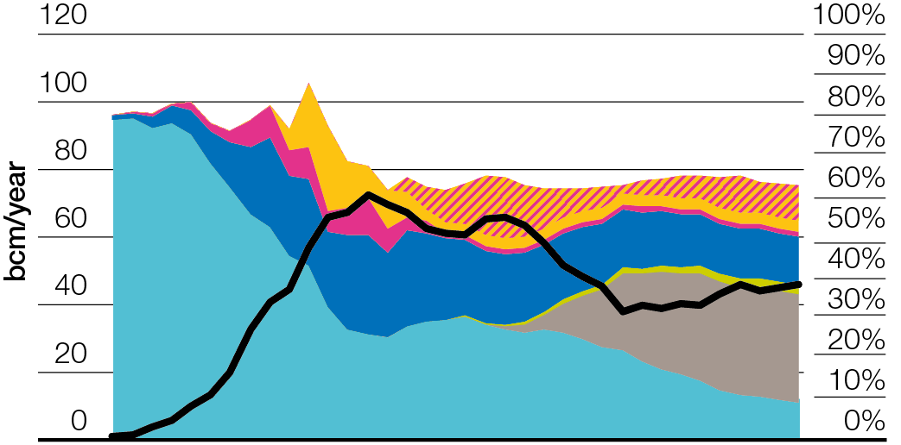
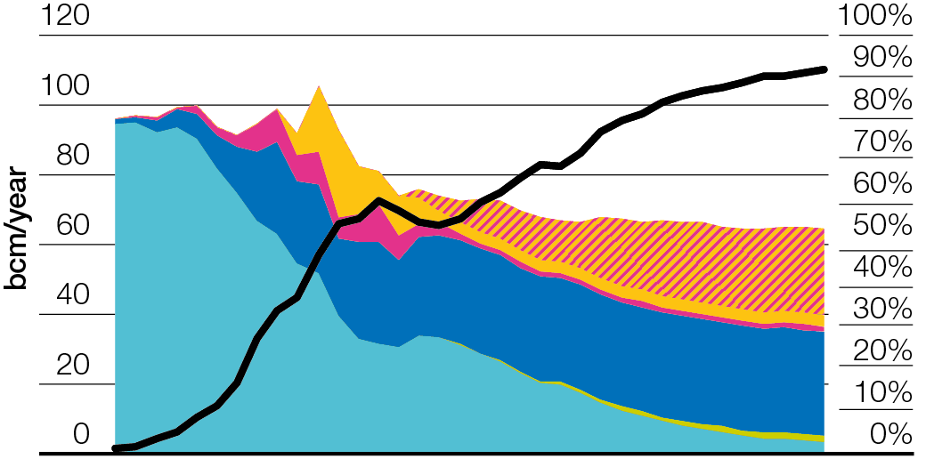
Sufficient gas supplies but uncertainty on the source
Consumer Power
Slow Progression
2000
2005
2010
2015
2020
2025
2030
2034
2000
2005
2010
2015
2020
2025
2030
2034
Notes:
This leads us to a set of gas supply scenarios which are basically a high import or low import case
I am highlighting the 2 extremes of our scenario range here.
The high indigenous production in Consumer Power leads to reduced Norway and generic import (LNG or Continental). In any given year it could be either leasing to an import dependency dropping to around 30-40% as shale comes on line.
Generic import could be either continental gas supplied by interconnectors or LNG
In Slow Progression with reduced investment in UKCS and no shale gas. Import dependency could rise to 90% with Norway being the biggest supply source and the balance coming from continental sources or LNG.
Generic import could be either continental gas supplied by interconnectors or LNG
Either way there is sufficient importation capacity to meet both peak and annual requirements.
For example in 2035 peak demand in Slow Progression is ~470 MCMD and import capacity plus storage is ~ 590mcmd

Slide 14
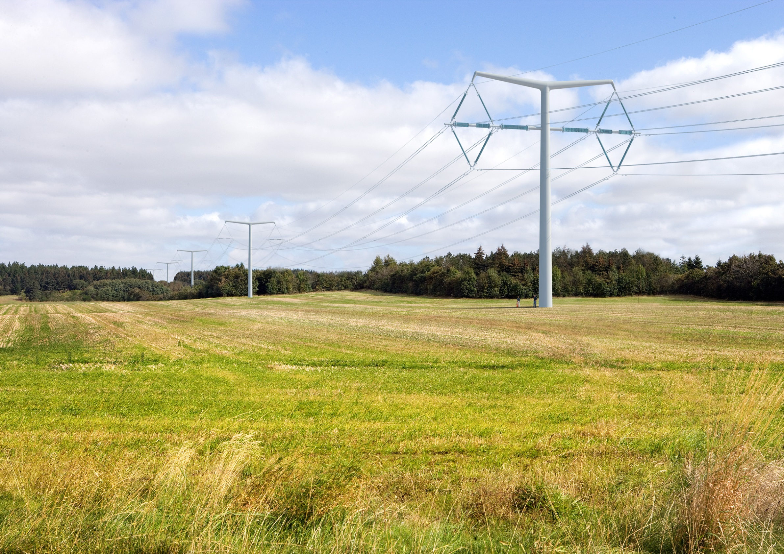
Energy supply summary
Electricity margins remain narrow for this winter, but the
tools are in place to manage, the 2018/19 Capacity
Market is designed to maintain standard.
Large increase in distributed generation will change the way the network is operated.
GB is a net importer of electricity in three of four scenarios.
Sufficient gas supplies across all scenarios but with uncertainty on the source.

