Slide 1
2023 – Non-statutory Consultation Overview
Norwich to Tilbury
June to August 2023
Notes:
COPPER

Slide 2
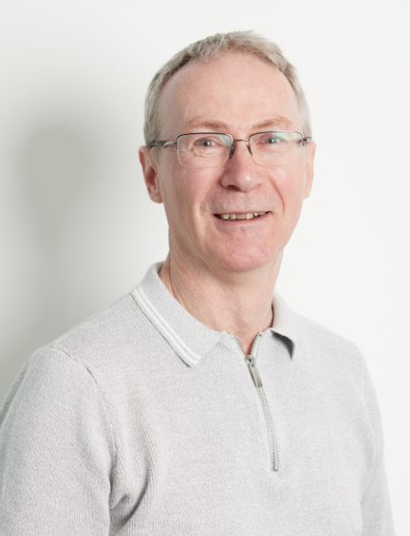
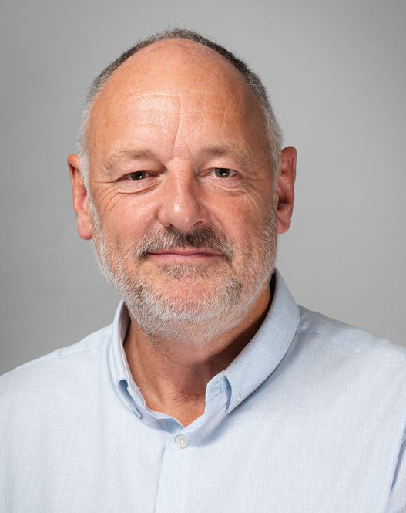
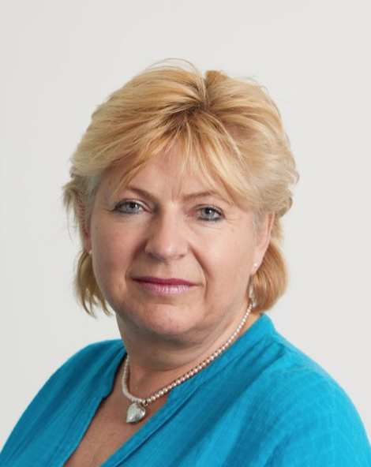
Meet the team
Simon
Senior Project Manager
Donna
Regional External Affairs Manager
Paul
Consents Officer
Tom
Project Community Relations Team
Ailsa
Project Community Relations Team
Notes:
Liam/Simon

Slide 3
Agenda
01 | Introduction and project background
02 | Regional context and need for reinforcement
03 | 2022 non-statutory consultation
04 | Our proposals for Norwich to Tilbury
05 | Public consultation June – August 2023
06 | Q&A
Notes:
Liam/Simon

Slide 4
01
Introduction and project background

Slide 5
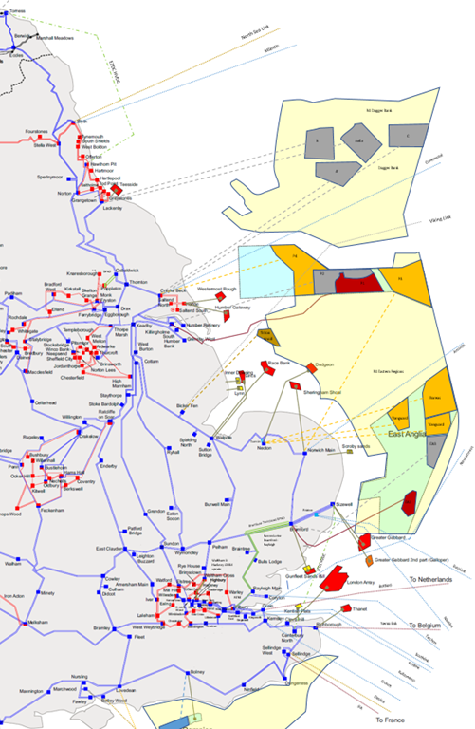
The challenge
Significant amount of energy generation above current capacity connecting into Norwich and Necton.
the Climate Emergency – net zero by 2050
government's offshore wind ambition - 50 GW by 2030
offshore wind connection points and network reinforcements are required up and down the East Coast.
Notes:
Donna

Slide 6
The Great Grid Upgrade
Norwich to Tilbury is part of The Great Grid Upgrade – the largest overhaul of the electricity grid in generations.
The Great Grid Upgrade will play a big part in the UK government’s plan to boost homegrown power.
It will help the UK switch to clean energy, by enabling the connection of more renewable and low carbon electricity and will create long lasting benefits to households and businesses across the UK.
Notes:
Donna

Slide 7
02
Regional context and need for reinforcement

Slide 8
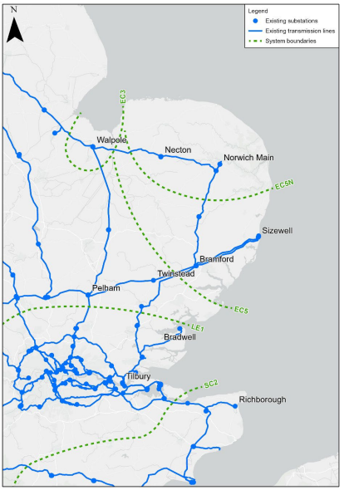
The existing transmission network
East Anglia’s 400,000 Volt (400 kV) electricity transmission network was built in the 1960s to supply regional demand, centred around Norwich and Ipswich. With the growth in new energy generation from offshore wind, nuclear power and interconnection with other countries, there will be more electricity connected in East Anglia than the network can currently accommodate.
Over the next decade we expect between 14,000 MW and 18,500 MW of new generation and new interconnection to connect in the region.
Our existing power lines do not have sufficient capacity to accommodate this new generation.
Notes:
Graham/Liam
Reference Norfolk Boreas pause and Nick Winser report
We are working to upgrade the existing transmission network in East Anglia, however these upgrades alone will not be sufficient.
East Anglia GREEN is a key part of our wider investment programme to upgrade our electricity transmission network in East Anglia to ensure we meet this future energy transmission demand.

Slide 9
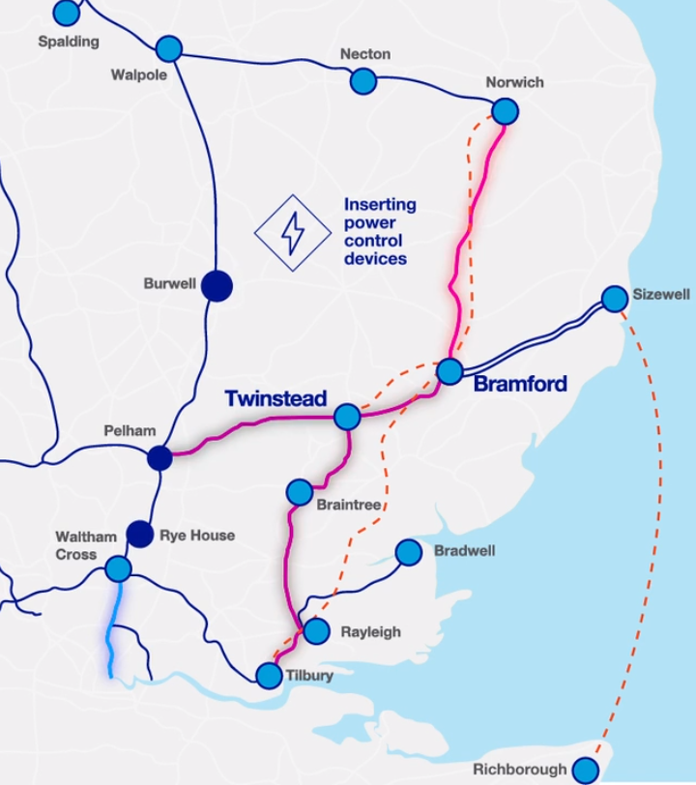
Increasing the capacity of the existing network
Before we consider the potential need to build new lines, we will always look to maximise the amount of power that can flow through the existing network. That is the case here:
installing power control devices (at Pelham, Rye House and Waltham Cross)
increasing the voltage of a section of line from Waltham Cross to London
re-wiring existing overhead lines with conductors that can carry more power, from Norwich to Rayleigh, and from Bramford to Twinstead and Pelham.
This is still insufficient to deliver the capacity required - we are therefore looking at options to build new reinforcements:
Norwich to Tilbury Reinforcement
Bramford to Twinstead Reinforcement
Sea Link – a subsea link between East Anglia and Kent.
Notes:
Graham/Liam
Updated map expected 12th April

Slide 10
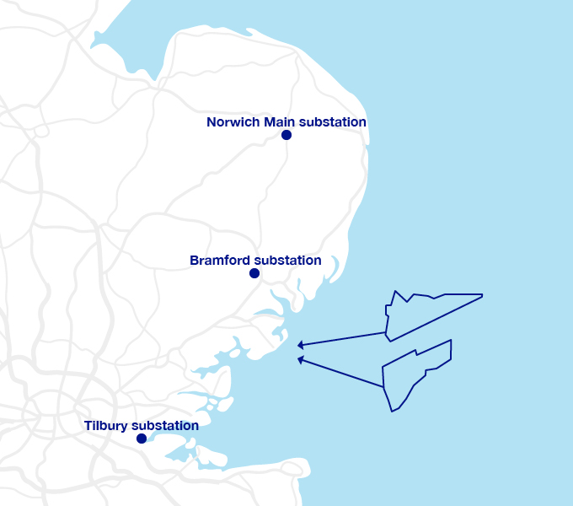
Connecting other customers
Three signed connection customers:
North Falls - Extension to the existing Greater Gabbard Wind Farm off the coast of Essex.
Five Estuaries - Sister project to the existing 353 MW Galloper Wind Farm, 30 km off the coast of Essex.
Tarchon Energy – Developing an interconnector between the UK and Germany
Notes:
Graham/Liam
existing transmission infrastructure insufficient to accommodate additional generation connections – combination of electrical (design) limitations and physical (access) constraints.

Slide 11
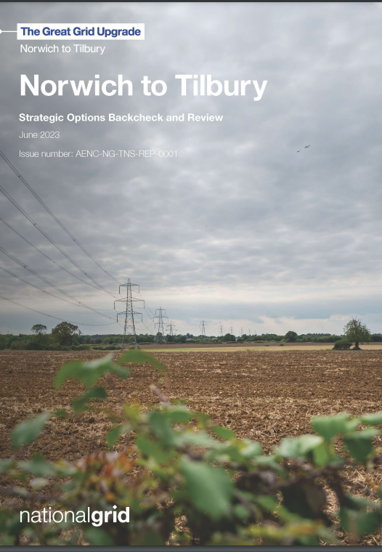
Strategic Options Backcheck and Review (SOBR)
We have carried out a backcheck and review of the strategic options to reinforce the network in East Anglia
The SOBR has tested the assumptions and interim conclusions made to date based on the latest information available.
It also updates the cost figures provided and presents the technical information in a more user-friendly style.
Notes:
Simon/Liam

Slide 12
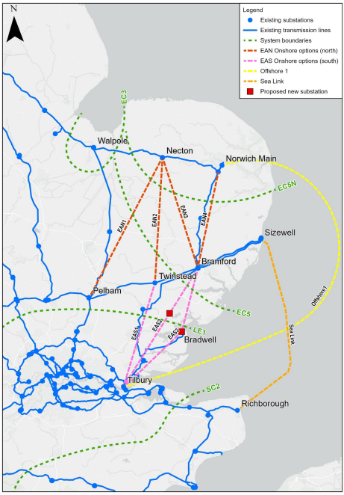
Offshore option
We have considered offshore options, including a connection between the existing substation at Norwich and the existing Tilbury substation - approximately 220 km
This is proven technology but there are particular challenges in this instance:
Capacity of HVDC is one third that of an overhead line.
High-voltage alternating current (HVAC) and High-voltage direct current (HVDC) conversion. Not without impacts and cost.
Thames estuary
Capital cost would be £895million for current proposal and approx. £4billion for simplest offshore design
Notes:
Simon/Liam

Slide 13
Onshore vs. Offshore cost summary
Item | Onshore AC | Offshore DC
 | Norwich to Bramford (AENC) + Bramford to Tilbury via customer substation ( ATNC) | Norwich Main to Tilbury Does not connect customers
Capacity (GW) | 6.9 | 6.0
Length approx (KM) | 180 | 220
Capital cost (£m) | 895.00 | 4,096.50
Lifetime cost (£m) | 1,231.00 | 4.661.00
Notes:
Simon/Donna

Slide 14
03
2022 non-statutory consultation

Slide 15
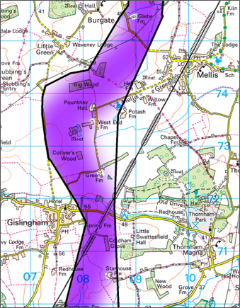
2022 non-statutory consultation
Wrote to all homes within 1km of the edge of preferred corridor.
Briefed all local authorities along the route.
Provided a comprehensive online and face-to-face approach to consultation, covering 12 public events and 12 online webinars. More than 3,000 people attended an event or webinar.
Provided consultation materials online, at events or via one of 13 information points across the consultation zone.
Received 3,787 feedback submissions, including 2,138 feedback forms.
Notes:
Donna

Slide 16
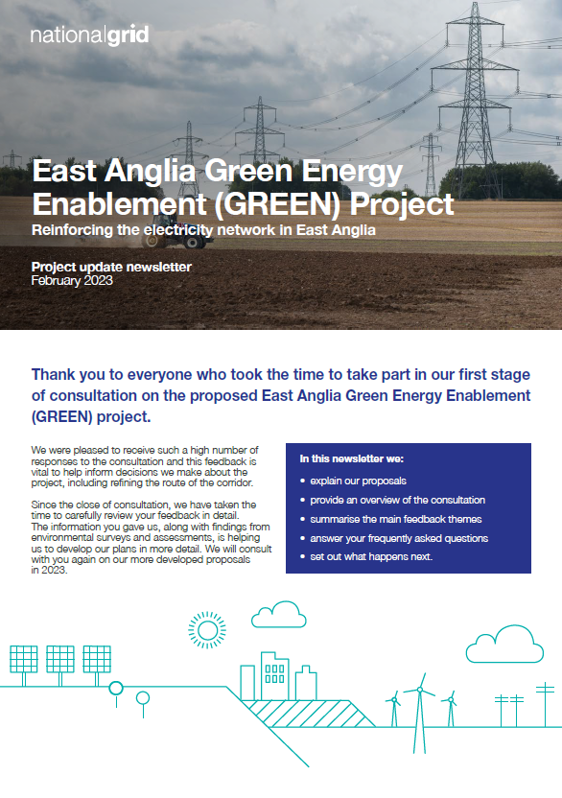
Activity since the 2022 consultation
Sought landowner access for surveying activity.
Published our 2022 non-statutory consultation newsletter, issued to over 50,000 properties.
Continued to engage with stakeholders and elected representatives, including local authorities, environmental bodies and MPs across the Project area.
Undertaken scoping for the environmental impact assessment.
Carried out environmental surveys and appraisals to provide more detail on the potential environmental effects of the proposals to inform routeing.
Reviewed feedback and continued to develop our design proposals.
Notes:
Donna

Slide 17
04
Our proposals for Norwich to Tilbury
Notes:
Paul

Slide 18
Planning and Regulatory Context
The
Holford & Horlock
Rules
Notes:
Simon/Donna

Slide 19
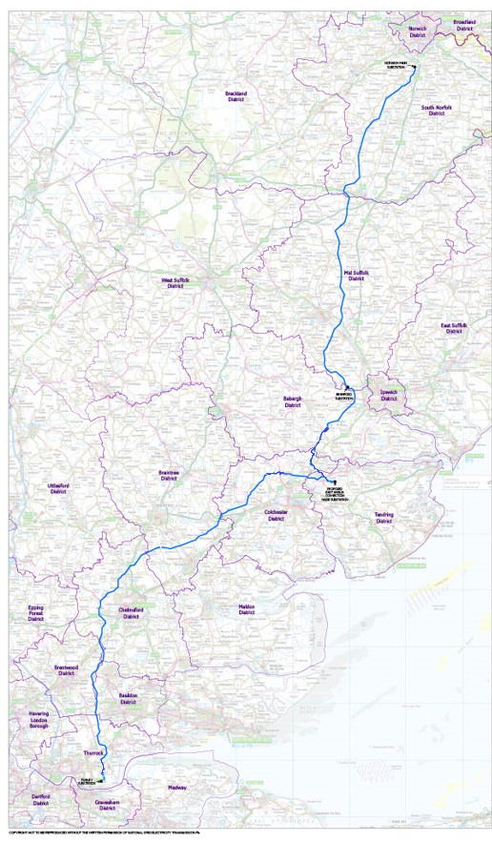
Our proposals for Norwich to Tilbury
Our proposals for reinforcement include:​
New 400 kV overhead line between Norwich and Bramford (AENC in NOA)​
New 400 kV overhead line between Bramford and Tilbury (ATNC in NOA)​
Underground cables through Dedham Vale AONB and additional undergrounding within its setting and where required.
New 400 kV substation, to be connected into the new Bramford – Tilbury circuit, to connect North Falls and Five Estuaries offshore wind farms and Tarchon Interconnector.
Key supporting infrastructure, including cabling sealing end (CSE) compounds.
Notes:
Paul

Slide 20
Changes from last year - informed by feedback and technical assessments
We have made five changes outside the 2022 preferred route corridor:
East of Wortham Ling
North of Flowton
West of Great Wenham
West of Writtle
Further east at Ingatestone
We have increased undergrounding at the following locations:
Total of ~14.6km from Notley Enterprise Park through the AONB to EACN
Total of ~5.3km near Great Horkesley
~0.7km at Fairstead
~4.6km from north of Lower Thames Crossing to Tilbury Substation
Moved outside the graduated swathe but within the 2022 corridor in a number of other locations
Notes:
Paul

Slide 21
Design Development Report and preferred route alignment
Design Development Report
sets out alternatives identified in feedback and why preferred or not
explains development of current preferred draft alignment including as informed by feedback
Preferred route alignment
environmental constraints
planning allocations and applications
existing infrastructure
2022 non-statutory consultation feedback
Notes:
Paul

Slide 22
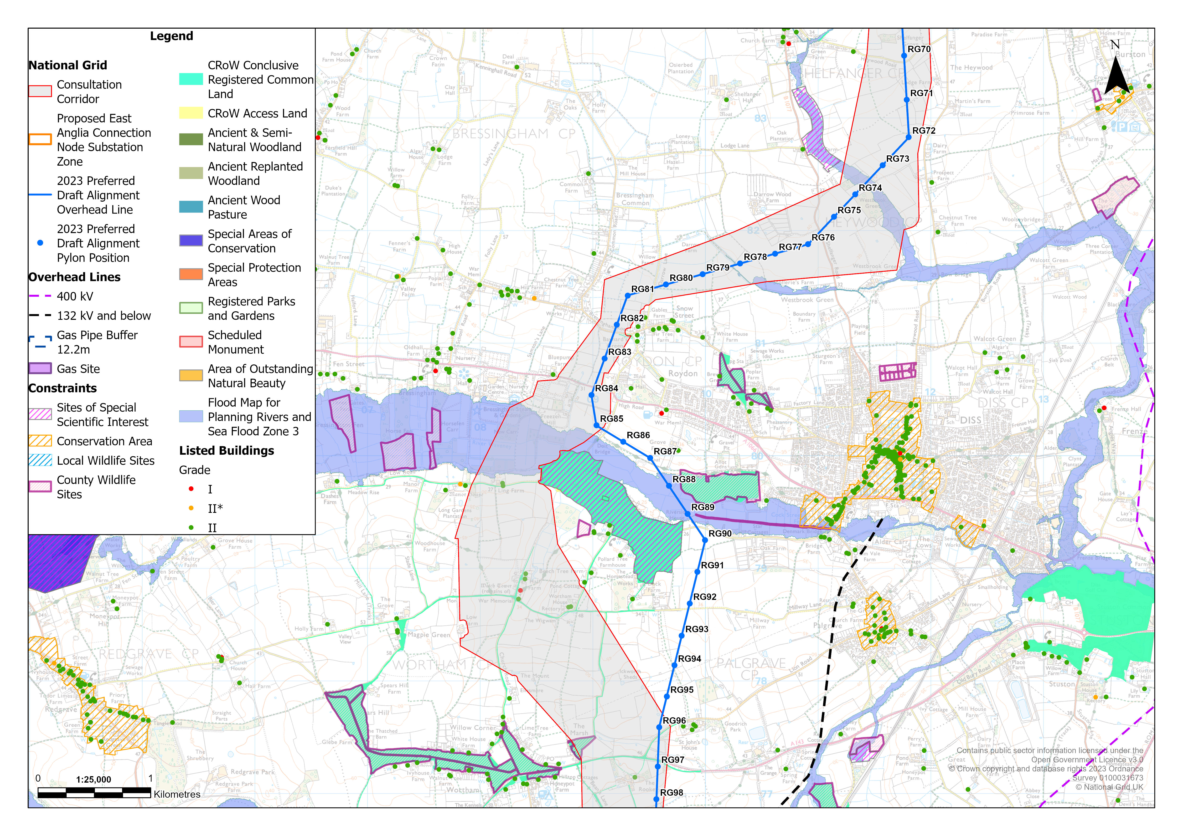
DISS
Notes:
Paul

Slide 23
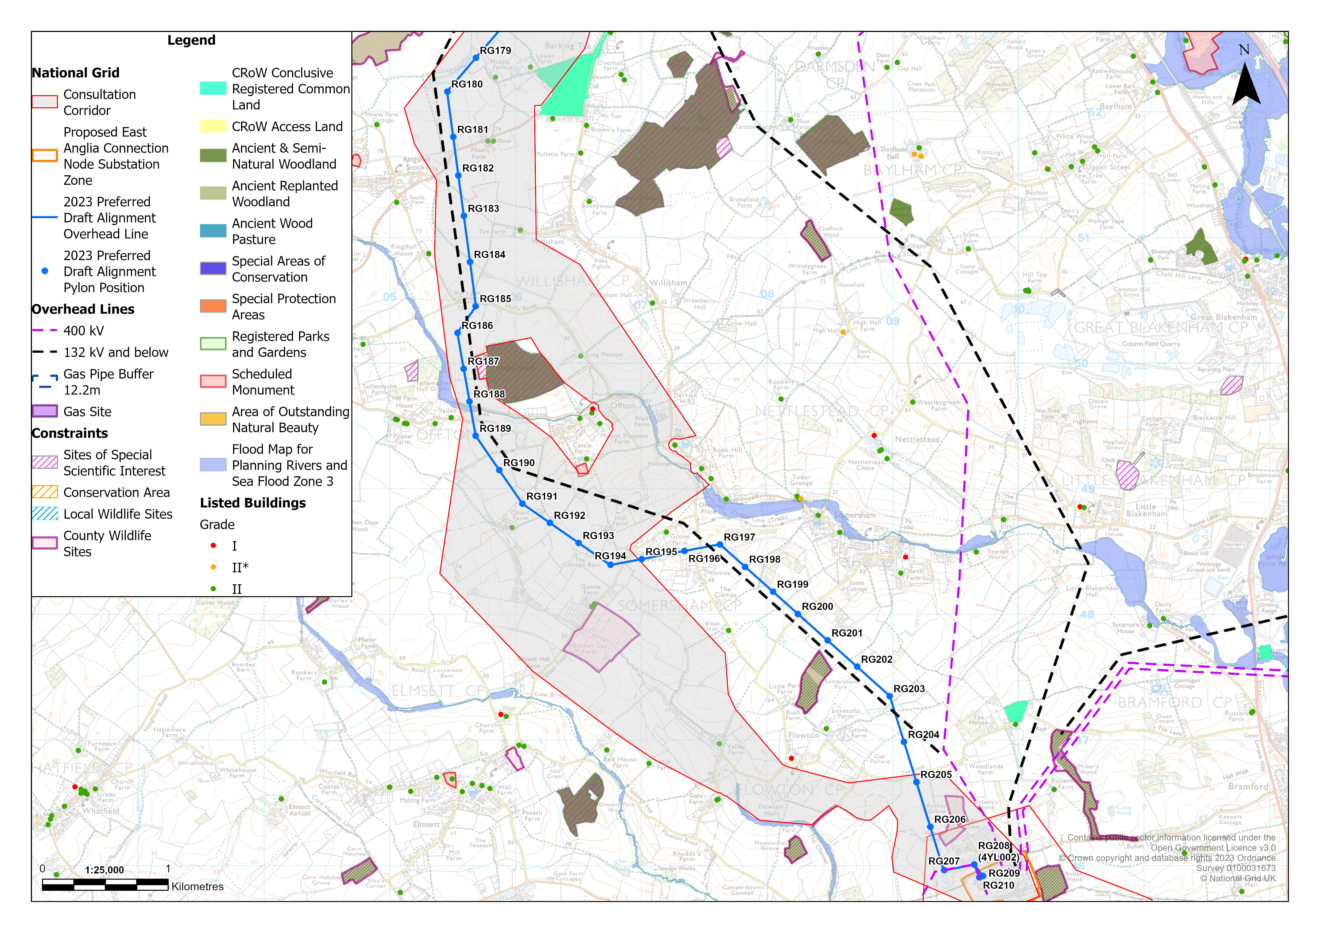
OFFTON TO BRAMFORD
Notes:
Paul

Slide 24
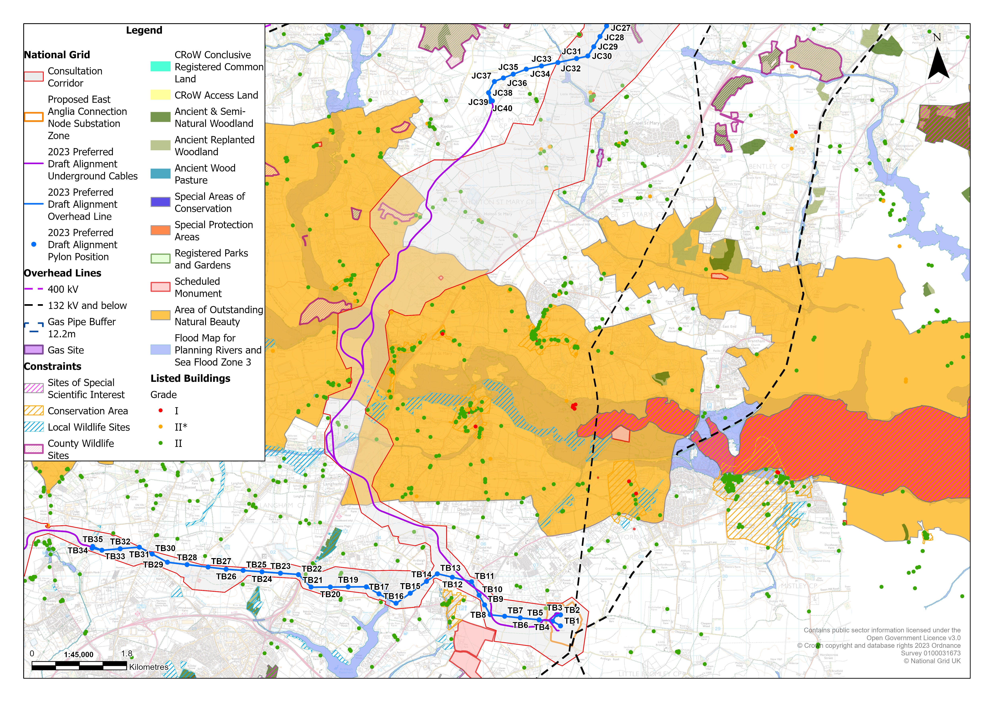
DEDHAM VALE AONB TO CONNECTION SUBSTATION
Notes:
Paul

Slide 25
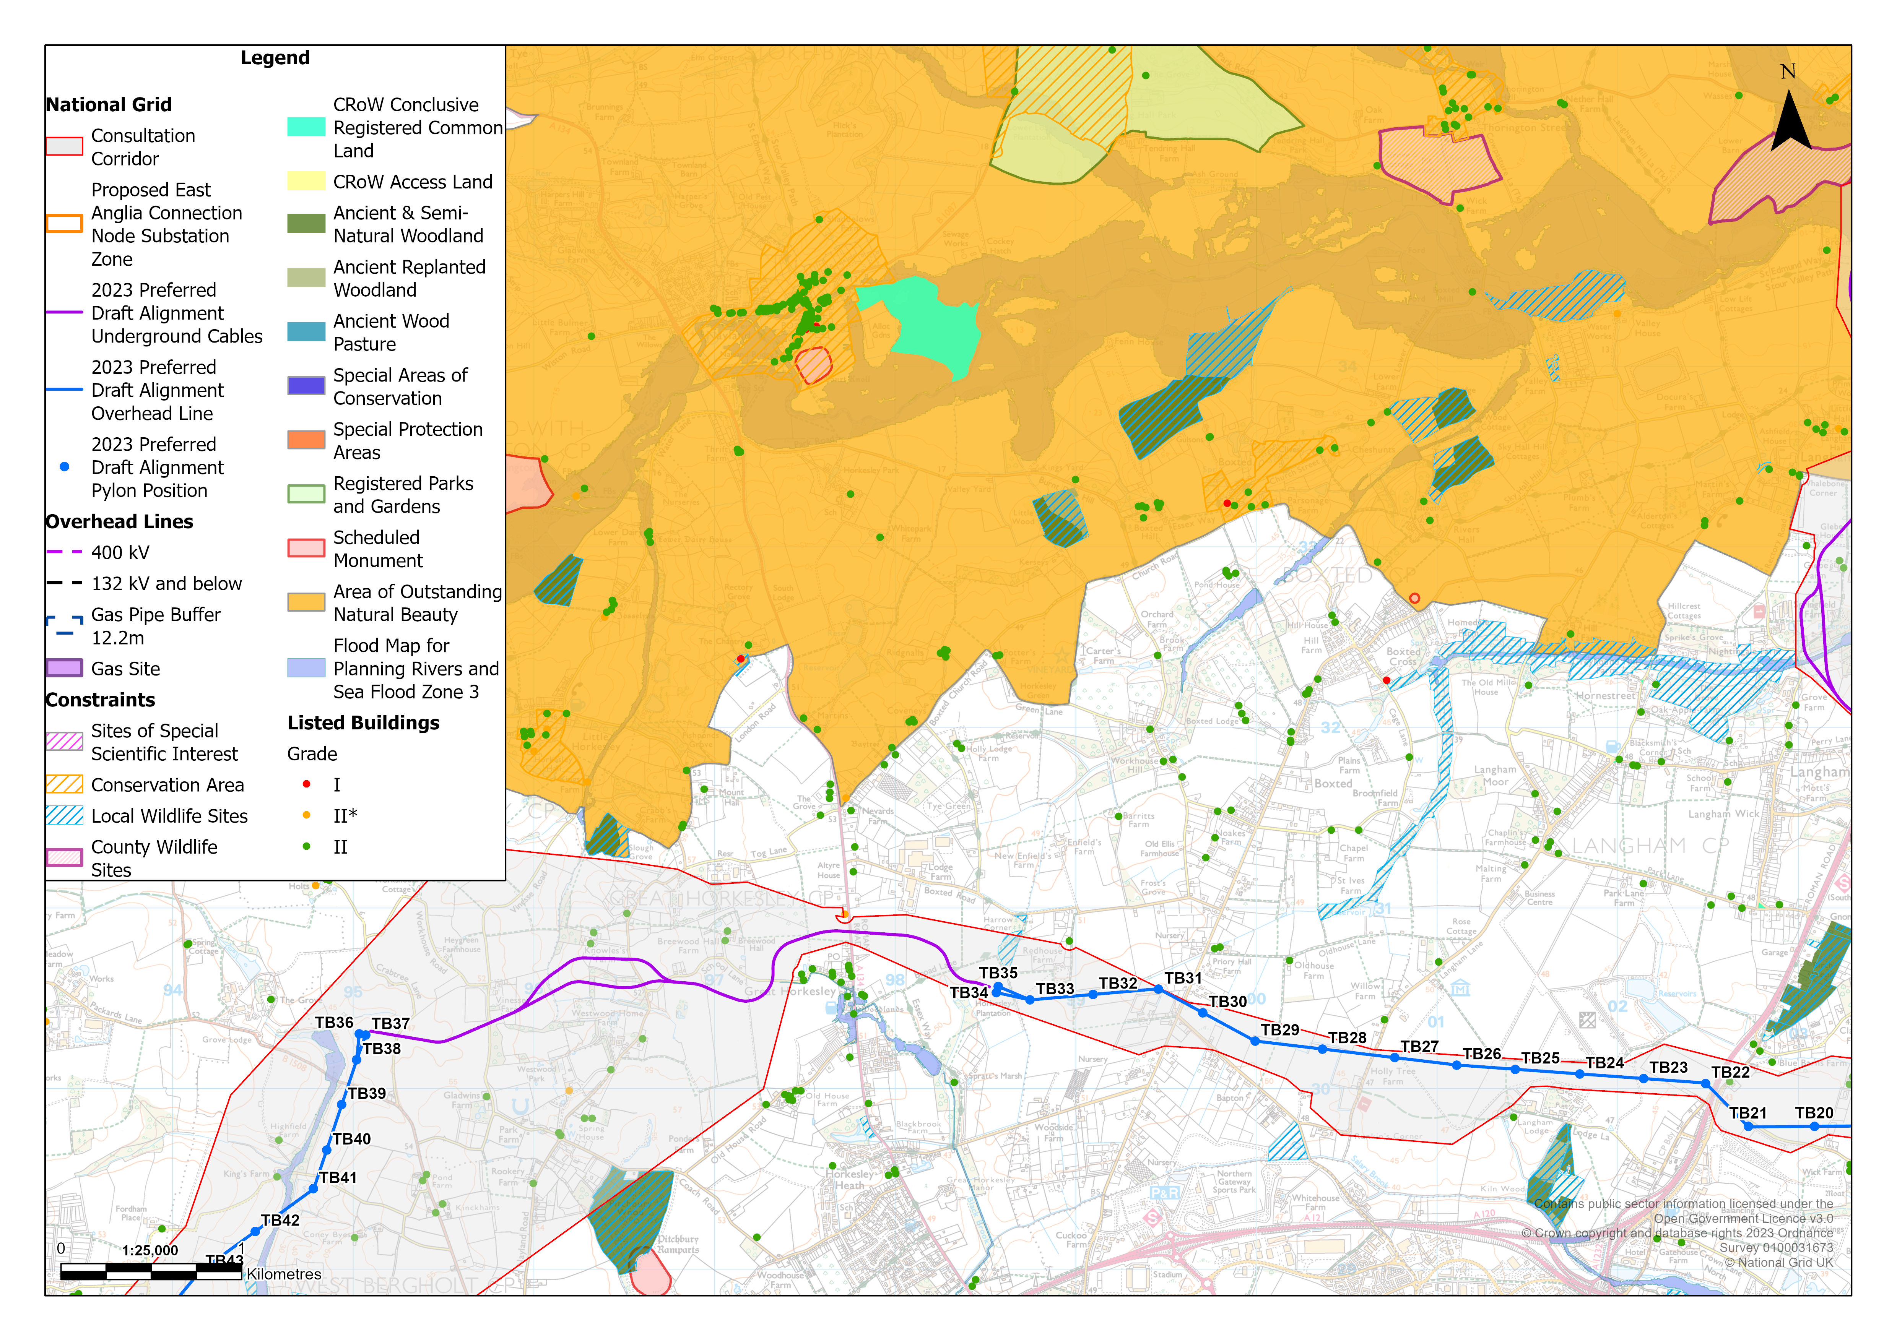
ARDLEIGH TO GREAT HORKESLEY
Notes:
Paul

Slide 26
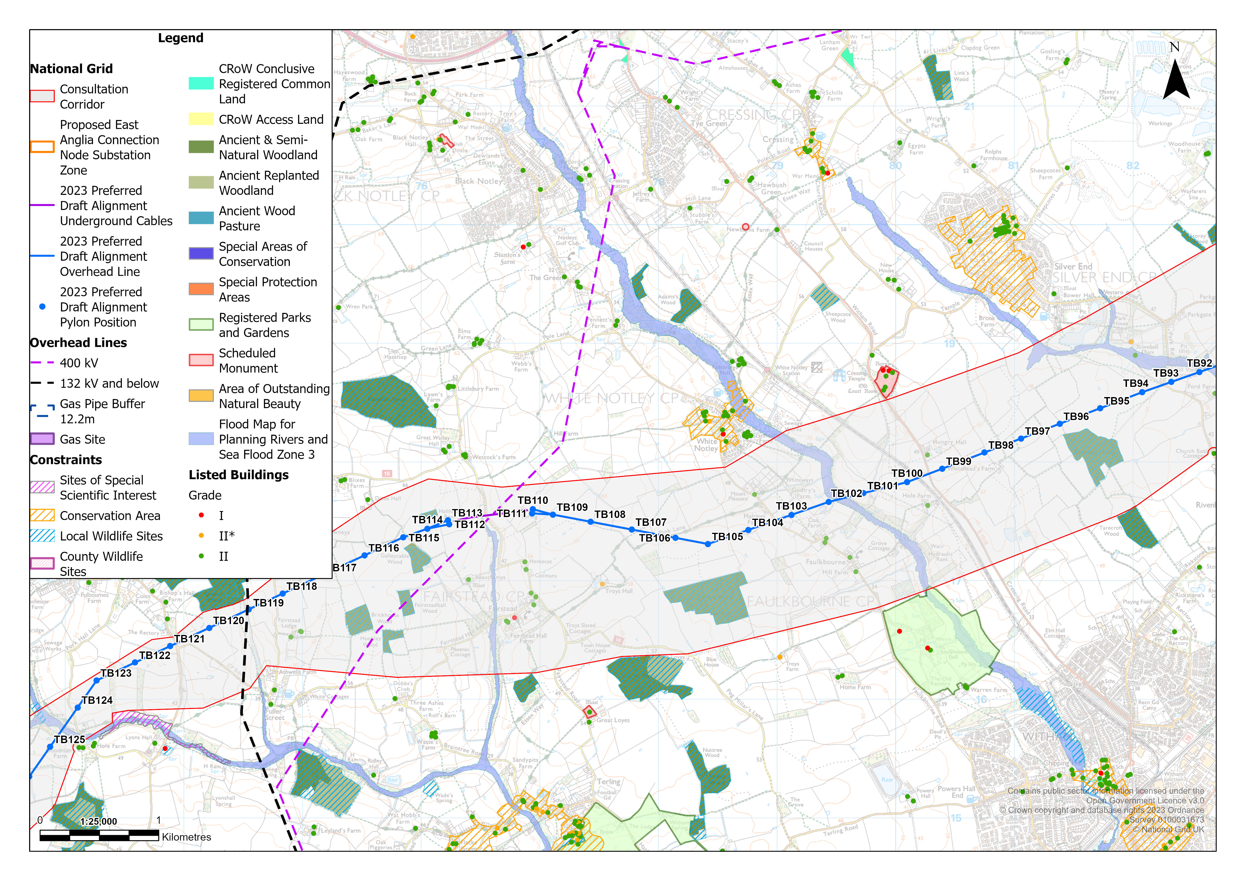
FAIRSTEAD
Notes:
Paul

Slide 27
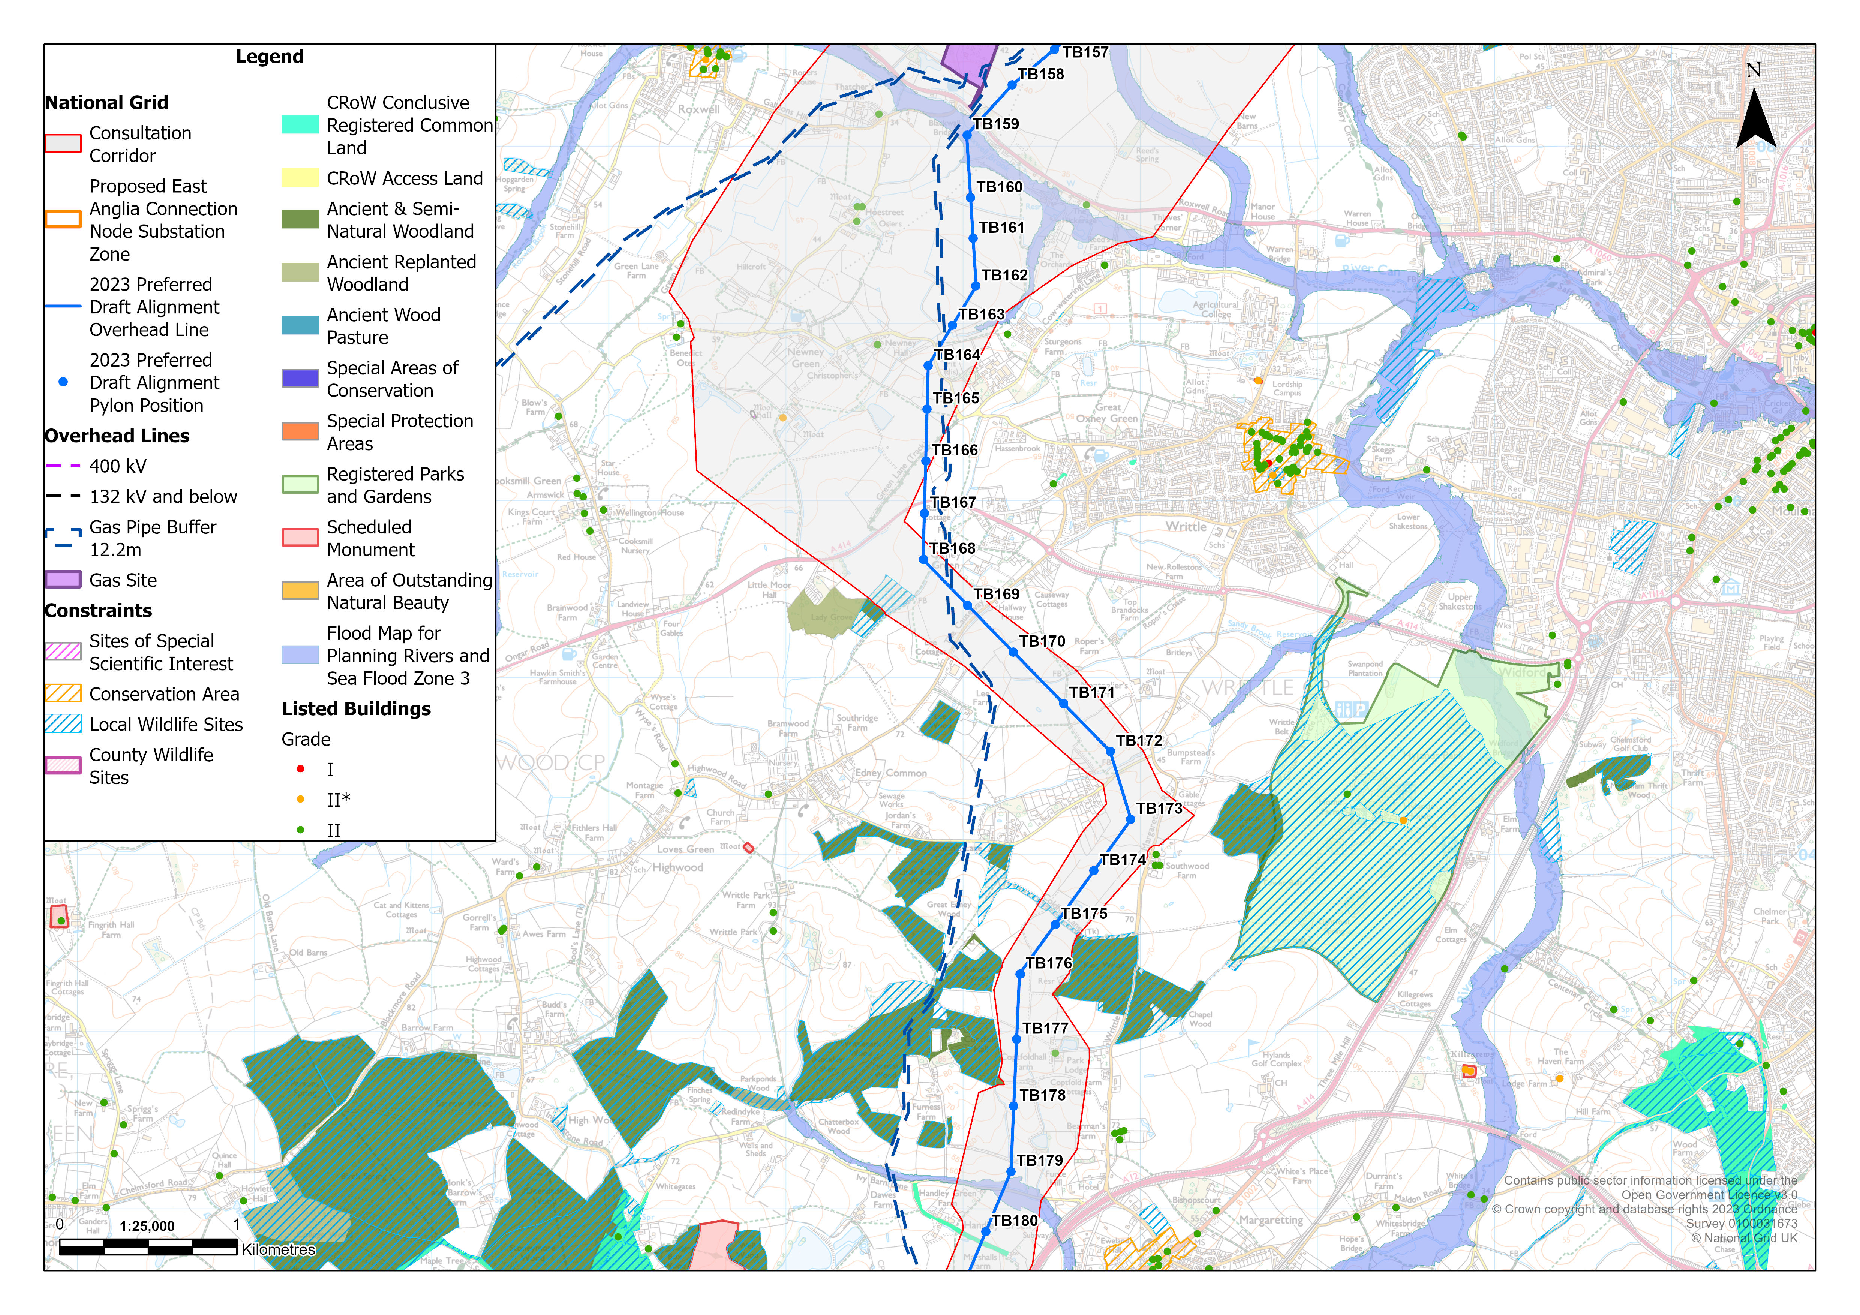
WRITTLE TO EDNEY COMMON
Notes:
Paul

Slide 28
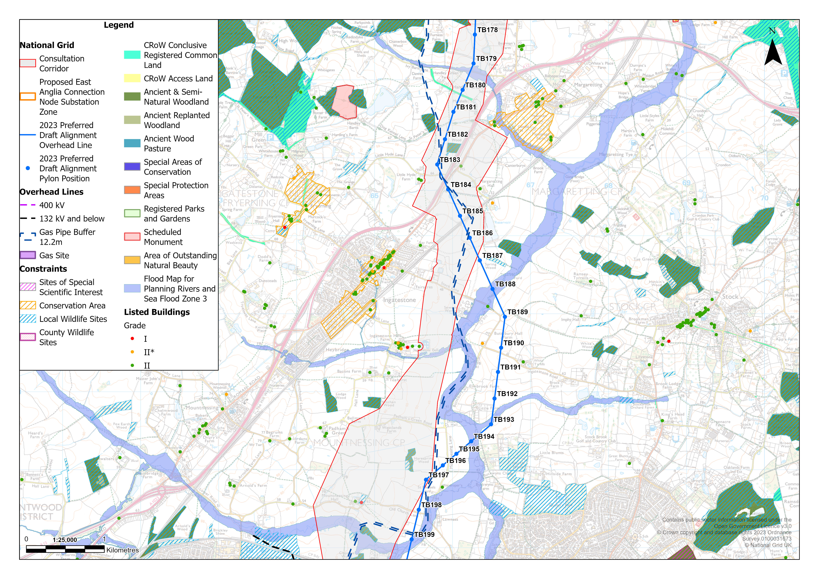
INGATESTONE
Notes:
Paul

Slide 29
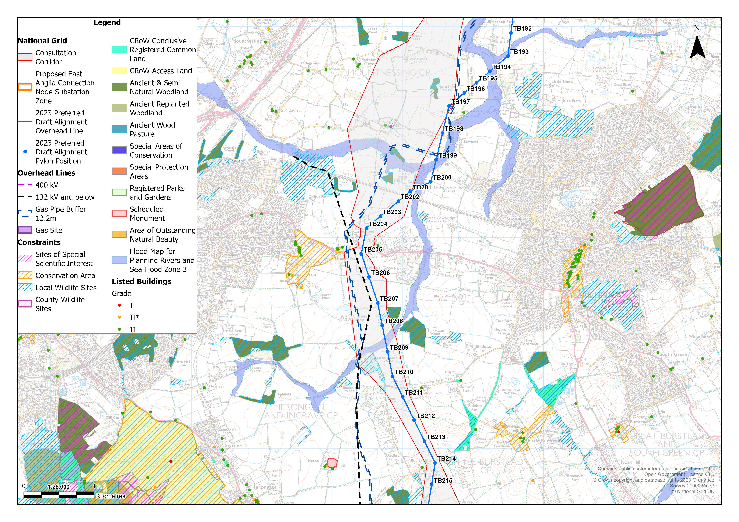
HUTTON
Notes:
Paul

Slide 30
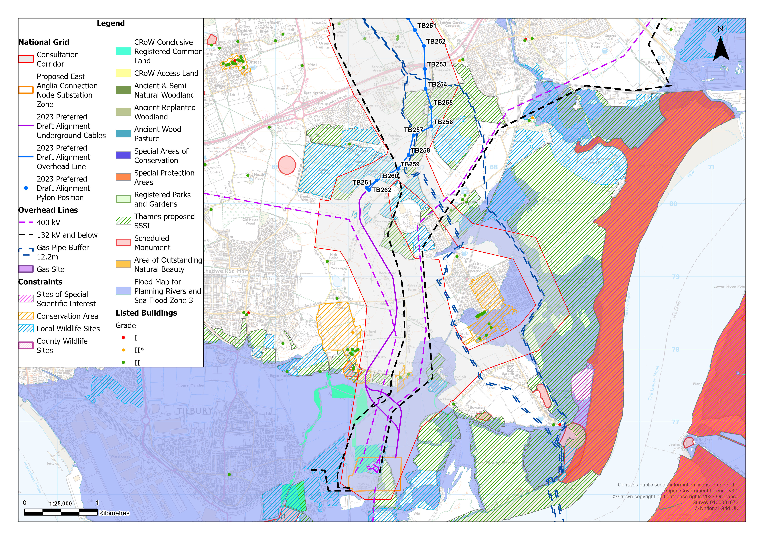
LOWER THAMES CROSSING TO TILBURY SUBSTATION
Notes:
Paul

Slide 31
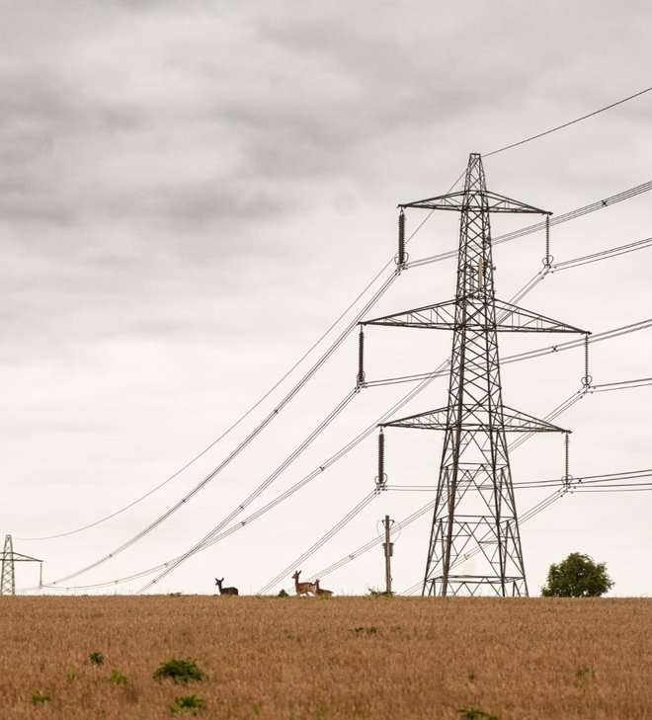
Maps of our proposals
Maps showing the entire length of our proposed alignment are available on our website: www.nationalgrid.com/norwich-to-tilbury
Alternatively, you can scan the QR code below:
Notes:
Paul

Slide 32
05
Public consultation June – August 2023

Slide 33
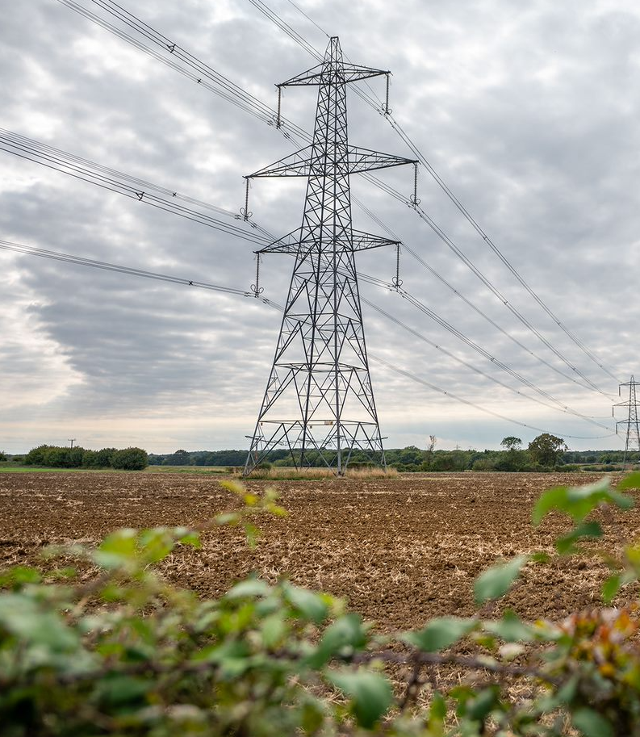
Timing and duration
Our public consultation began on 27 June and closes on 21 August 2023, lasting eight weeks.
We set out our proposed plans for public consultation in a Consultation Strategy, which was reviewed and commented on by local councils.
We have advertised the consultation through a newsletter to over 50,000 households along the route, and through local and regional media, and on social media.
Notes:
Donna

Slide 34
2023 non-statutory public consultation
The purpose of this non-statutory consultation is to:
Provide an overview of the updated project.
Present our preferred draft alignment, including pylon positions, the locations of underground cables, cable sealing ends (CSEs), and the connection node substation.
Explain where we have made changes to our proposals since the last consultation.
Ensure all stakeholders have the opportunity to provide feedback on our work to date.
Outline the next steps, the programme and how we will further develop our proposals.
Notes:
Donna

Slide 35
How we are consulting
Materials being published
Project website, which includes an interactive map to show proposals, FAQs, online feedback form and land team information
Project Background Document 2023, Design Development Report 2023, Strategic Options Backcheck and Review 2023, and 2022 Non-Statutory Consultation Feedback Report
maps and supporting technical documentation, including overview plans and preferred draft alignment section plans (June 2023)
Consultation newsletter
Feedback form
Stakeholder briefings
MPs
local elected representatives
parish councils
Consultation events
12 face-to-face events
four online webinars
direct engagement, including youth engagement and outreach to seldom heard groups and organisations
Notes:
Donna

Slide 36
Webinar events
Date | Time
Wednesday 5 July | 1-2pm
Tuesday 25 July | 7-8pm
Saturday 12 August | 10-11am
Thursday 17 August | 10-11am
Notes:
Donna

Slide 37
Information Points
Venue | Address | Venue | Address
Long Stratton Library | The Street, Long Stratton, NR15 2XJ | Coggeshall Library | 29 Stoneham Street, Coggeshall, Colchester, CO6 1UH
Diss Library | Church Street, Diss, IP22 4DD | Writtle Library | 45 The Green, Writtle, Chelmsford, CM1 3DT
Stowmarket Library | Milton Road, Stowmarket, IP14 1EX | Chelmsford Library | County Hall, Market Road, Chelmsford, CM1 1QH
Suffolk County Council | Endeavour House, 8 Russell Rd, Ipswich, IP1 2BX | Ingatestone Library | High Street, Ingatestone, CM4 9EU
Capel Library | The Street, Capel St Mary, Ipswich, IP9 2EF | Brentwood Borough Council | Town Hall, Ingrave Road, Brentwood, CM15 8AY
Tendring District Council | 88-90 Pier Avenue, Clacton on Sea, Essex, CO15 1TN | Tilbury Library | Kanmore House, 16 Civic Square, Tilbury RM18 8AD
Colchester Library | Trinity Square, Colchester, CO1 1JB
Notes:
Donna

Slide 38
How to respond to our consultation
to sign up for a webinar or speak to the project team, please contact us using the details below.
Website: www.nationalgrid.com/norwich-to-tilbury
Email: contact@n-t.nationalgrid.com
Call: 0800 151 0992
feedback forms are available:
online
at information points
at public events.
you can request paper copies of all materials and feedback forms over the phone or by email.
if you feel your land may be affected by the proposals, please contact the Lands Team at Fisher German:
Email: Norwich-Tilbury@fishergerman.co.uk
Call: 0808 175 3314
Notes:
Donna

Slide 39
06
Q&A

Slide 40
Consultation events
Venue | Local authority | Venue | Local authority
Tasburgh Village Hall Tuesday 18 July 1-6pm | South Norfolk | Langham Community Centre Thursday 13 July 2-7pm | Colchester
Tibenham Village Hall Monday 10 July 1-6pm | South Norfolk | Witham Public Hall Thursday 20 July 2-7pm | Braintree
Diss Youth and Community Centre Friday 7 July 2-7pm | South Norfolk (directly adjacent to Mid Suffolk) | Chelmsford City Racecourse Wednesday 12 July 2-7pm | Chelmsford
Blackbourne Community Centre Tuesday 11 July 11am-4pm | Mid Suffolk | Brentwood Centre Thursday 6 July 2-7pm | Brentwood
Copdock Village Hall Wednesday 19 July 2-7pm | Babergh | Basildon Sporting Village Friday 21 July 2-7pm | Basildon
Lawford Venture Centre Saturday 8 July 11am-4pm | Tendring | The Civic Hall Monday 17 July 2-7pm | Thurrock
Notes:
Donna

